Slide 1
Summative task | Formative elements | Activities to assess Formative elements
Narrative
Explanation
Essay
Source analysis
Interpretation analysis
Notes:
Print A3

Slide 2
Cheat sheet for slide 13
Summative task | Formative elements
Narrative | Knowledge, especially chronology, selection of this, correct sequencing Historical thinking – often change, continuity, similarity and difference Literacy: structural awareness, vocabulary, disciplinary/conceptual language
Explanation | Knowledge, especially causally linked examples, selection of these, strong chronology Historical thinking – often cause and consequence, selection of factors Literacy: structural awareness, vocabulary, disciplinary/conceptual language
Essay | Knowledge, especially breadth and depth, sense of period, selection of Historical thinking – often significance judgements, but plenty else Literacy: structural awareness, vocabulary, disciplinary/conceptual language, sustained line of argument Multiplicity of factors/elements – willingness to emphasise and downplay
Source analysis | Comprehension & inference skilling – tone, content, message, language of period studied Ability to use details to support analysis Provenance – origin, type etc, and analytical limitations of these. Utility, reliability etc Knowledge of context, likely purpose, audience etc within context etc
Interp analysis | Comprehension – angle/tone/perspective, content Knowledge: information that is included and excluded, ‘light-touch’ historiog. Judgements on how convincing, comparisons with others Literacy – conditional expressions, incorporating evidence into sentences etc

Slide 3


Assessment in History
Hugh Richards
Subject Leader of History
Huntington School
h.richards@huntington-ed.org.uk @MisterHistry

Slide 4
The challenge of GCSE assessment
‘Old’ GCSE | Current GCSE
Shorter, 4/5/6 mark description answers Very little writing of ‘proper’ essays Smaller, chronologically narrower content Consequently narrower vocabulary required Comparatively little literacy and SPaG needed | Much of assessment centred around longer 9/10/15 mark answers Essay writing a core component Broader, chronologically varied content Far wider vocabulary needed – both period-specific content vocab and what’s needed for conceptual expression Far greater expectations of literacy and SPaG

Slide 5
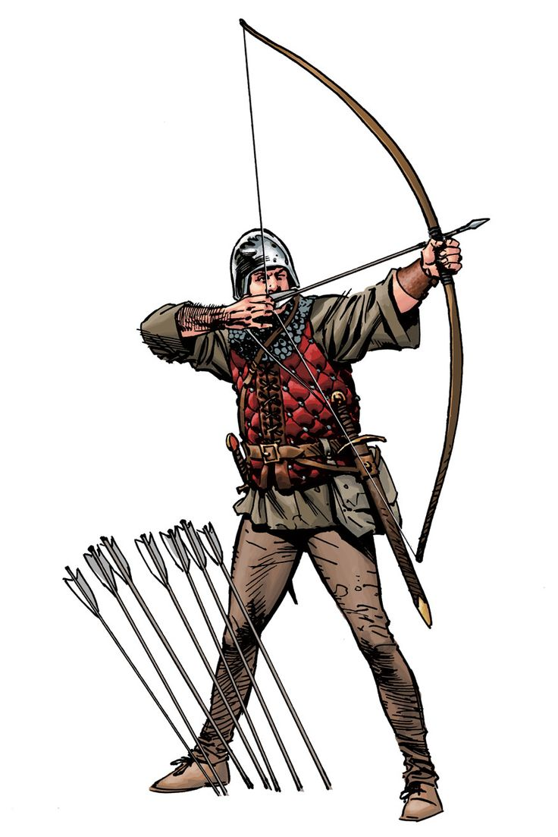
Aims and purpose
Better prepare students for exams by not writing endless practice questions.
Help you assess their understanding better and help you forensically intervene within the classroom
Realistic and pragmatic approaches
Evidence informed ‘best bets’
Sharing of good ideas

Slide 6
Assessment
Activity:
What do the following words/phrases mean?
Write a brief definition and give a brief example of each one.
Assessment for Learning (AfL)
Formative Assessment
Summative assessment

Slide 7
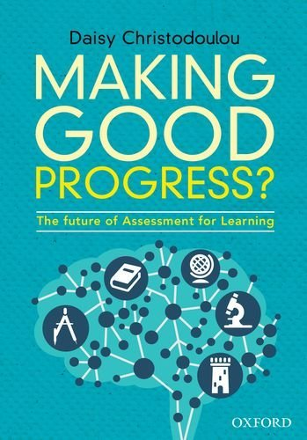
Responsive teaching
Formative assessment has been hijacked/misunderstood
Think instead about ‘responsive teaching’
Make it a as forensic and diagnostic as possible

Slide 8
Deliberate practice
If you wanted to run a marathon, how would you measure your progress towards your final goal?
Some sensible ideas
Download a plan!
Stick to the plan!
Start with some shorter runs and build up distance
Do some speedwork
Spend some time in the gym
Monitor improvements on all of these activities – eg distance logged, speed of shorter runs, time spent in gym, weights lifted, etc.
Some less sensible ideas!
Run a marathon in every training session
Record times
If you are getting faster, that shows you are making progress.
This is the equivalent of getting better at essay writing by just repeatedly writing full essays/exam questions/paragraphs

Slide 9
Deliberate practice
So how should we break down complex skills in History?
Use deliberate practice
“Deliberate practice has several characteristics that set it apart from what we might call “naive practice,” which is essentially just doing something repeatedly, and expecting that the repetition alone will improve one’s performance… it’s all about putting a bunch of baby steps together to reach a longer-term goal.” (Ericsson)

Slide 10
What does this mean for formative and summative assessment?
Once we accept that complex skills can be broken down into small pieces, we can see that formative and summative assessments have to measure different things
Formative assessment
Assessment for learning
Aim is to provide helpful next steps.
Break down complex skills and isolate the parts so you can see which bits a pupil is strong or weak at – measure the deliberate practice
Don’t use grades!
Use frequently
Summative assessment
Assessment of learning
Aim is to provide an accurate shared meaning
Measure the complex skill itself – this is the end goal
Use grades – which are essentially methods of communicating shared meanings
Don’t do too frequently!

Slide 11
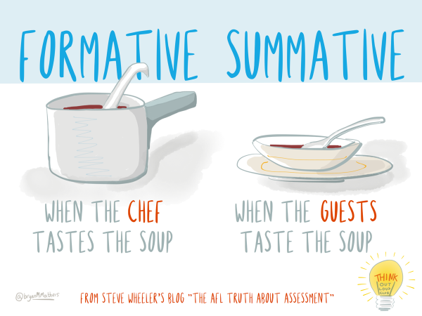

Slide 12
What does this mean for formative and summative assessment?
Once we accept that complex skills can be broken down into small pieces, we can see that formative and summative assessments have to measure different things
Formative assessment
Assessment for learning
Aim is to provide helpful next steps.
Break down complex skills and isolate the parts so you can see which bits a pupil is strong or weak at – measure the deliberate practice
Don’t use grades!
Use frequently
Summative assessment
Assessment of learning
Aim is to provide an accurate shared meaning
Measure the complex skill itself – this is the end goal
Use grades – which are essentially methods of communicating shared meanings
Don’t do too frequently!

Slide 13
What does “Deliberate practice” look like in History?
How can we formatively assess and responsively teach the History-specific knowledge and skills
Activity:
Suggest ways we could break down the major summative tasks in history into the formative skills within each.

Slide 14


Multiple choice questions
Diagnostically test knowledge
What is the capital of Moldova?
A. Baku
B. Tiblisi
C. Chisinau
D. Yerevan
E. Minsk
Distractors unambiguously wrong... but still plausible!
What is the capital of Bulgaria?
A. London
B. Doncaster
C. Mexico City
D. Sofia
E. New York
‘Distractors’ unambiguously wrong... but not plausible!
Create unambiguously wrong, but plausible, distractors!

Slide 15
Multiple choice questions
Target misconceptions
How did the Soviet totalitarian system under Stalin differ from that of Hitler and Mussolini?
It built up armed forces.
It took away human rights.
It made trade unions illegal.
It abolished private land ownership.
Don’t start with the right answer – start with the misconception!!
Identify a misconception
Ask a question, and turn the misconception into a distractor
Add in some more distractors and add in the right answer!

Slide 16
Multiple choice questions
Diagnostically testing knowledge: how to use MCQs
In a Year 7 lesson…
In a GCSE lesson…

Slide 17
Deliberate practice:
beyond MCQs
Preparing to write narratives
Timelines to emphasise change over time.
  Use as a form of assessment, and better retrieval practice:
  Two tone – what they can remember from their head, then extra added.
  Change arcs drawn on
Spot the historical thinking in a paragraph
Useful/not useful knowledge for each paragraph
Improve the language of a sentence – replace generic with specialist.
Similarity and difference tasks- Venn diagrams
- key words / vocab development task
- 9 words we need to see in the answer to the question
Site study: Label a site map of a site study to show where evidence of change can be found

Slide 18
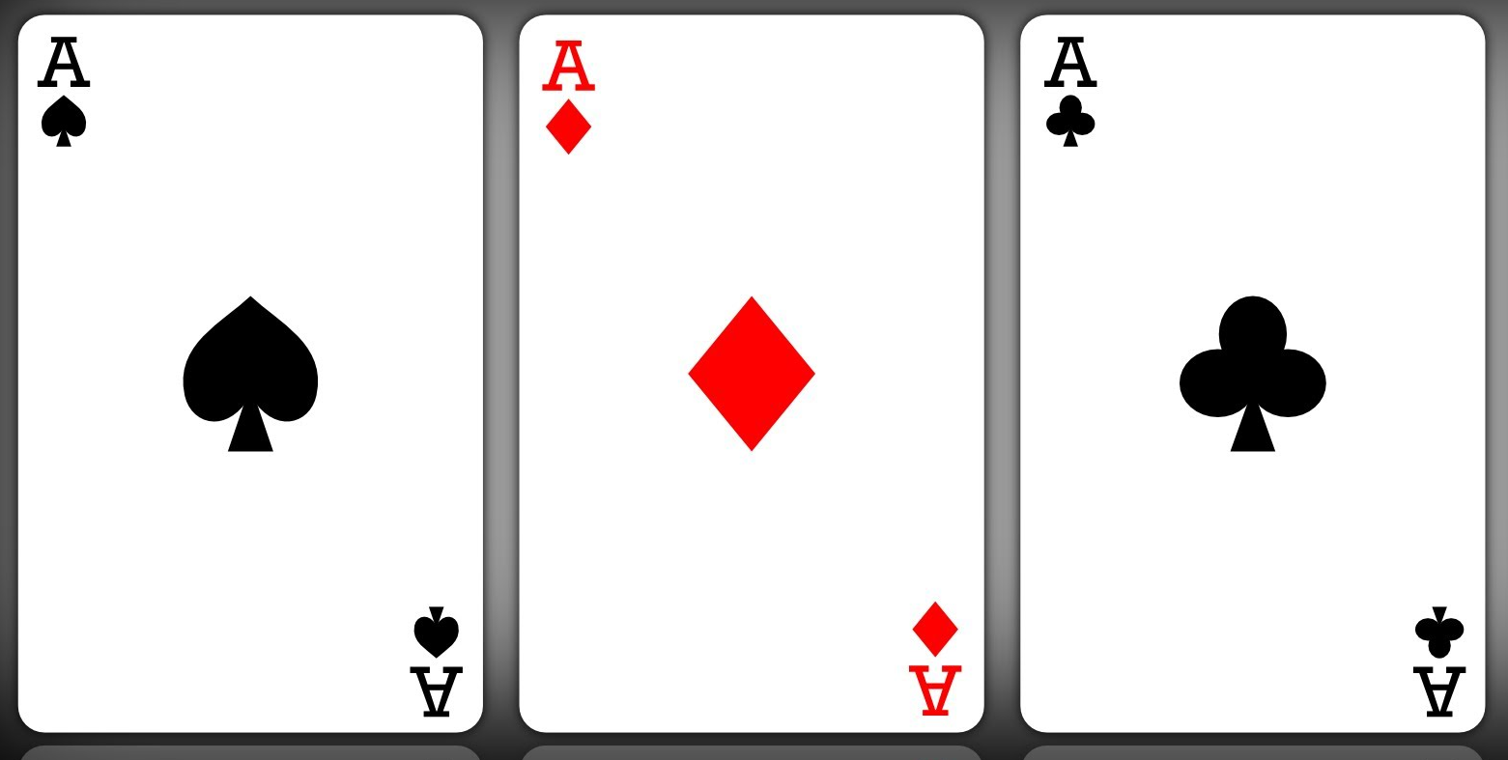
P1: | Key Evidence:
P2: | Key Evidence:
P3: | Key Evidence:
P1: | Key Evidence:
P2: | Key Evidence:
P3: | Key Evidence:
P1: | Key Evidence:
P2: | Key Evidence:
P3: | Key Evidence:
Get suggested structures from different students – use this as assessment info- how well do they understand the topic and question?
Then explore:
Which structure best answers the question?
Which is the best evidence to support each paragraph in the structure?

Slide 19
Deliberate practice:
beyond MCQs
Preparing to write explanations
Causation diagrams & modelling
Cause, and effects, write the sentence that links the two
Write a two sentence judgement that compares two factors
Identify the factors you could use to explain something
Lots of factual examples that could be categorised in factors
Vocabulary test on words you would expect to see in an explanation
  Because
  This meant that
  As a result

Slide 20
Which causation model works best?
Or do we need to suggest another one?
Model 1: linear combination
cause
Cause
event
cause
Model 2: no combination
Model 3: varied combinations
Cause
Cause
cause
cause
cause
event
cause
event

Slide 21
Deliberate practice:
beyond MCQs
Preparing for essays
Checklists – ability to isolate and test any of those elements
Old Lady in the Post Office
Planning grids
Playing-card plans

Slide 22
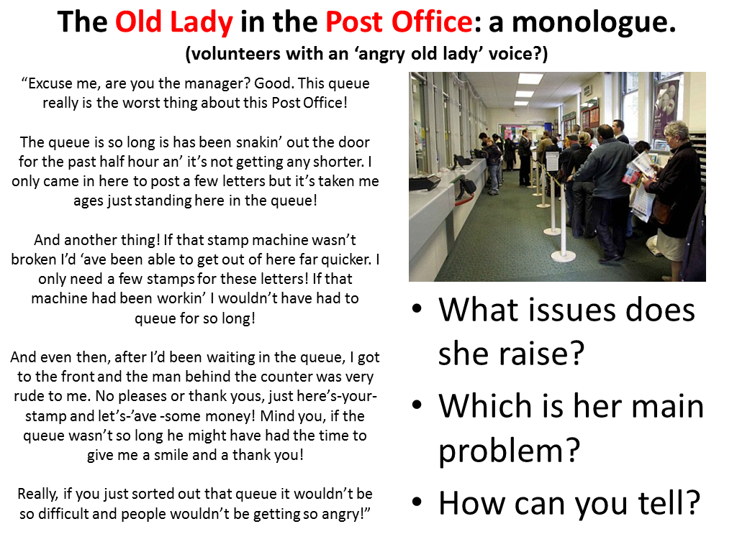
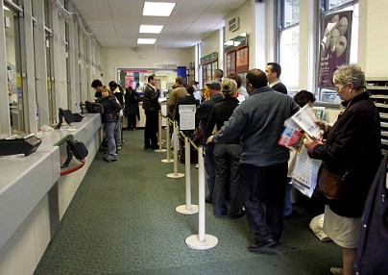
“Excuse me, are you the manager? Good. This queue really is the worst thing about this Post Office!
The queue is so long is has been snakin’ out the door for the past half hour an’ it’s not getting any shorter. I only came in here to post a few letters but it’s taken me ages just standing here in the queue!
And another thing! If that stamp machine wasn’t broken I’d ‘ave been able to get out of here far quicker. I only need a few stamps for these letters! If that machine had been workin’ I wouldn’t have had to queue for so long!
And even then, after I’d been waiting in the queue, I got to the front and the man behind the counter was very rude to me. No pleases or thank yous, just here’s-your-stamp and let’s-’ave -some money! Mind you, if the queue wasn’t so long he might have had the time to give me a smile and a thank you!
Really, if you just sorted out that queue it wouldn’t be so difficult and people wouldn’t be getting so angry!”
The Old Lady in the Post Office: a monologue.
(volunteers with an ‘angry old lady’ voice?)
What issues does she raise?
Which is her main problem?
How can you tell?

Slide 23

The Old Man in the Army Uniform: a monologue.
What issues does he raise?
Which is his main argument?
How can you tell?

Slide 24
Question: |  | Intro: Judgement/answer to the question in a single sentence
Issue and judgement on this issue | Evidence / factual details (bullet point only in plan) | Explanation – why is this issue relevant? Why is it more/less significant? (bullet point only in plan) |  | Final judgement sentence on this issue – often involving change over time
One hand
Other hand
Bonus third hand
Conclusion: restate judgment | Explain why your chosen factor/issue is the most significant. |  | Final sentence: Therefore, it is clear that…

Slide 25
Judgement:
P1: | Key Evidence:
P2: | Key Evidence:
P3: | Key Evidence:
Judgement:
P1: | Key Evidence:
P2: | Key Evidence:
P3: | Key Evidence:
Judgement:
P1: | Key Evidence:
P2: | Key Evidence:
P3: | Key Evidence:
Get suggested structures from different students – use this as assessment info- how well do they understand the topic and question?
Then explore:
Which structure best answers the question?
Which is the best evidence to support each paragraph in the structure?

Slide 26
Deliberate practice:
beyond MCQs
Adapt the principle:
Looking to describe the interpretation in 9 interpretations, but nothing more
Just summarise each interpretation and cut straight to which one is more convincing.
Just match existing knowledge to the interpretations

Slide 27
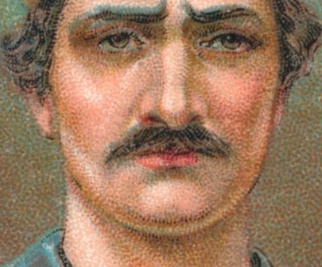
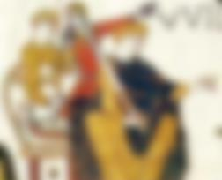
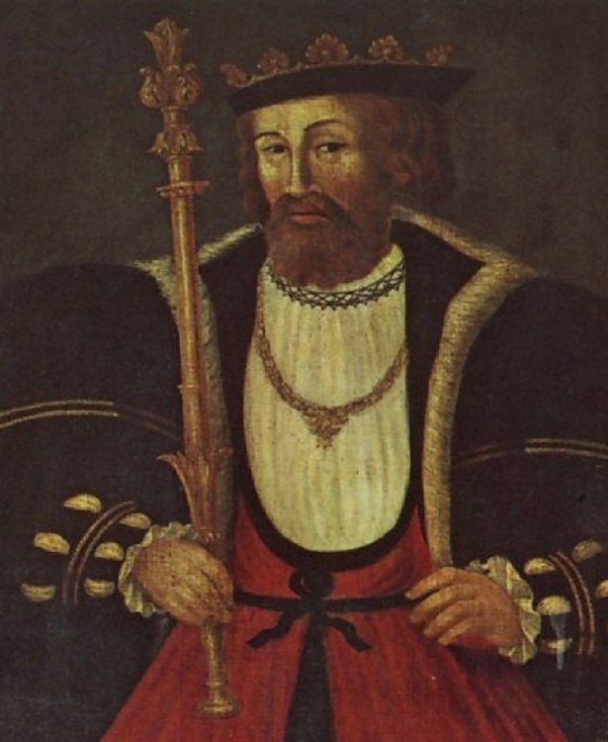
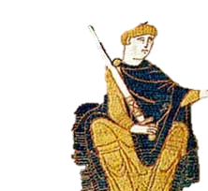


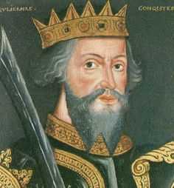
Bell Work: History Quiz… Name names!
How many of these people can you identify in the back of your book?
1
2
3
4
5
6
Notes:
All WtC – make point about deficiencies of the historical record. Only two contemporary ones are the middle two – top is the BT, bottom middle is his seal…
Number 3 very interesting and useful – painted during tudor era – impression of how a king would look. Similarity to the H8 Holbein very suspicious, but a good indication of how interpretations have been shaped by the time they are made in….
Why might they take on the shape they do?

Slide 28
Further contact
h.richards@huntington-ed.org.uk
@MisterHistry
Incorporation into planning – this is taking us ages!
Work out what you need to formatively build skills – invest some time in teaching skill rather than just practice a question, mark and DIRT – it’s liberating, and time-saving.
Next
steps

