Slide 1
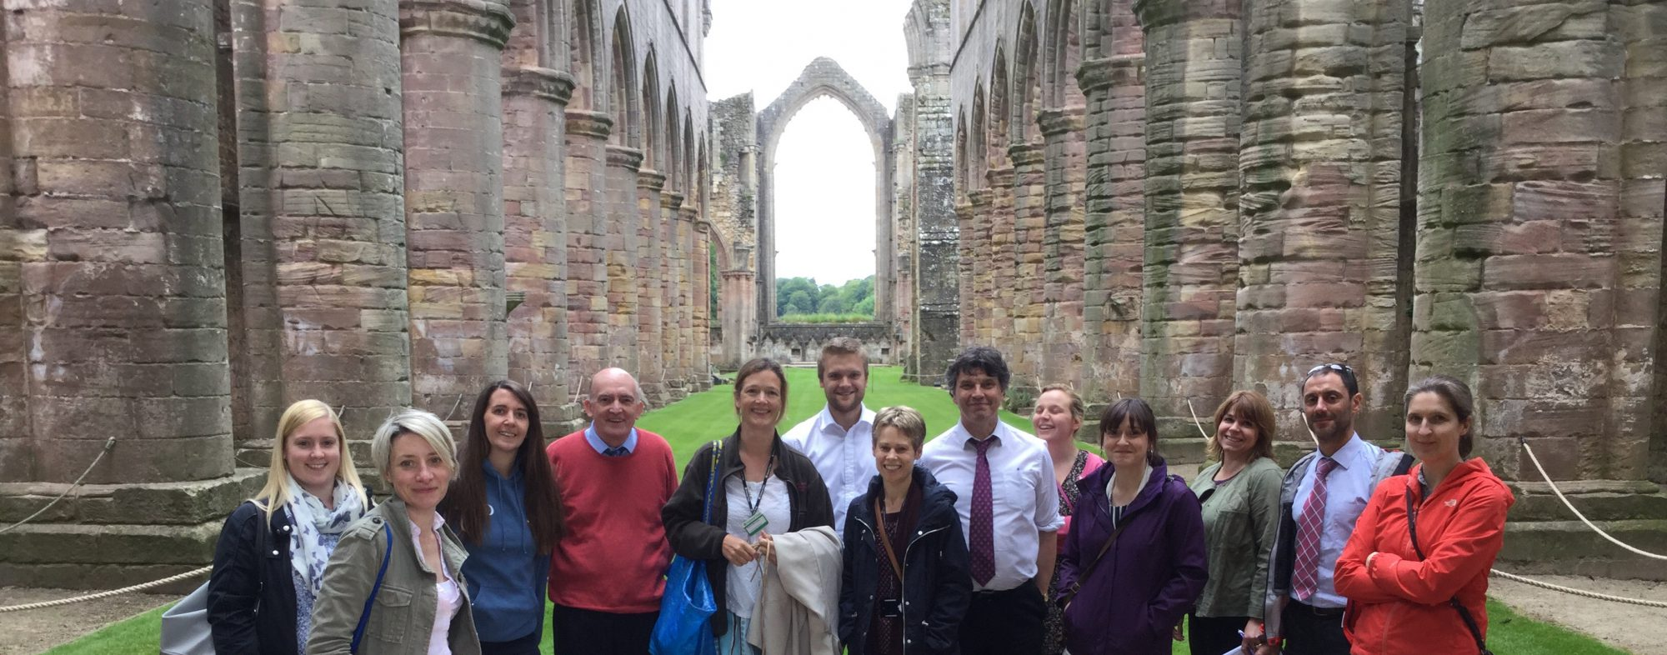
Welcome to York Clio : the network for History teachers
https://yorkclio.wordpress.com/

Slide 2

Dates for your Diary
History nerds – please send me details of up to 5 keen Year 11 or 12 historians. Three meetings over one year.
Tues 9th Oct: Dr John Jenkins discusses Why Becket is more than just a murder.
Wed 6th Feb : Exploring the Borthwick Archives, York
Thurs 27th June: Ian Dawson on Richard the III
      https://yorkclio.wordpress.com/

Slide 3
Dates for your Diary
HA Yorkshire History Forum, Wed 14th November 2018, at Leeds Trinity University
HA Tudor Day, 23rd March 2019, Friends Meeting House York
YorkClio Meetings
28th June : Using the archives at the Borthwick with students
21st June: Richard Kerridge on teaching History to the less able

Slide 4
Ofsted, latest thoughts
https://www.gov.uk/government/speeches/hmci-commentary-curriculum-and-the-new-education-inspection-framework
“The research… showed that there was a dearth of understanding about the curriculum in some schools. Too many teachers and leaders have not been trained to think deeply about what they want their pupils to learn and how they are going to teach it.” Amanda Spielman

Slide 5
What questions did Ofsted ask?
how do curriculum managers perceive knowledge within their curriculum?
what do curriculum managers do when designing, implementing and evaluating the curriculum?
how have curriculum managers developed the curriculum over time?
is there a common conceptual language employed by curriculum managers?

Slide 6
Alex Ford
Alex Ford is lead tutor on the PGCE History course at Leeds Trinity University and SHP Regional Advisor for Yorkshire and the Humber. Prior to 2016, he was head of a large and successful history department in Leeds. He has eleven years teaching experience in a range of secondary settings. Alex speaks at a wide range of educational conferences and has delivered workshops on planning, assessment and progression for Teach First, the Historical Association and the Schools History Project. He has also worked with OCR on the development of the new GCSE SHP History specification. Alex is currently writing the "Making of America" textbook for Hodder Education's new GCSE series.

Slide 7
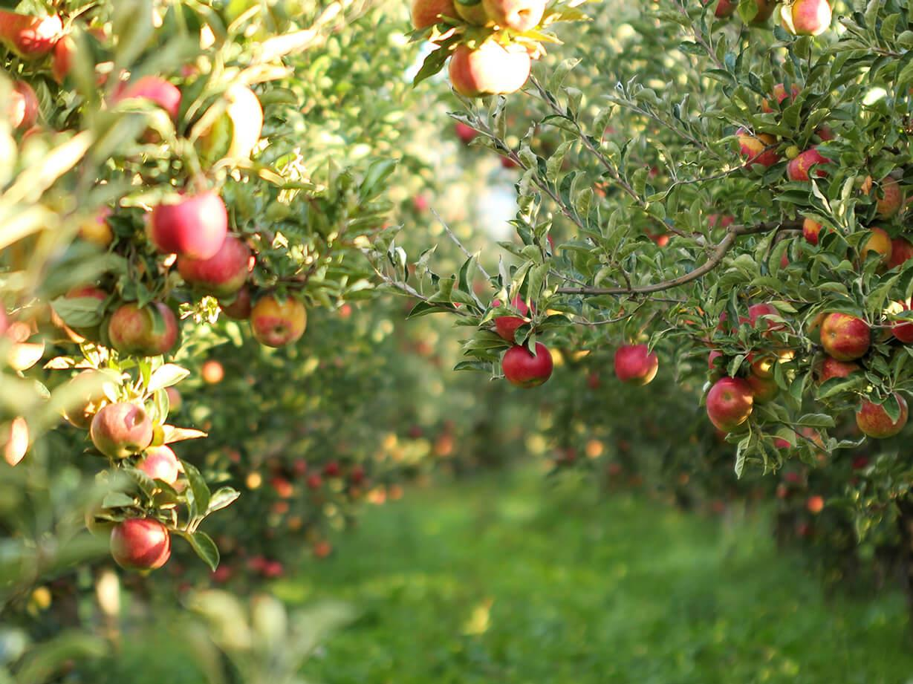
The first fruits…
What have we learned about new GCSEs? … And what should we do now?
Alex Ford - @apf102
Leeds Trinity University
This Photo by Unknown Author is licensed under CC BY-SA

Slide 8

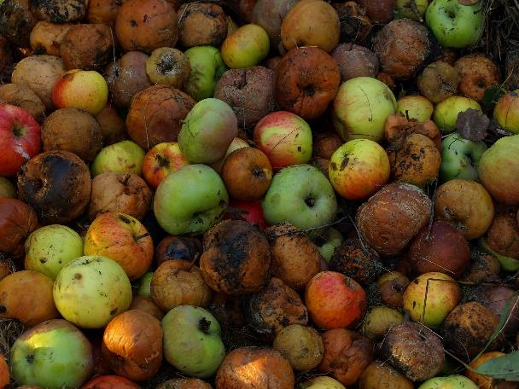

How were your GCSE ‘fruit’ this year? What questions do you have now?

Slide 9

Five things we learned from this year’s results…

Slide 10
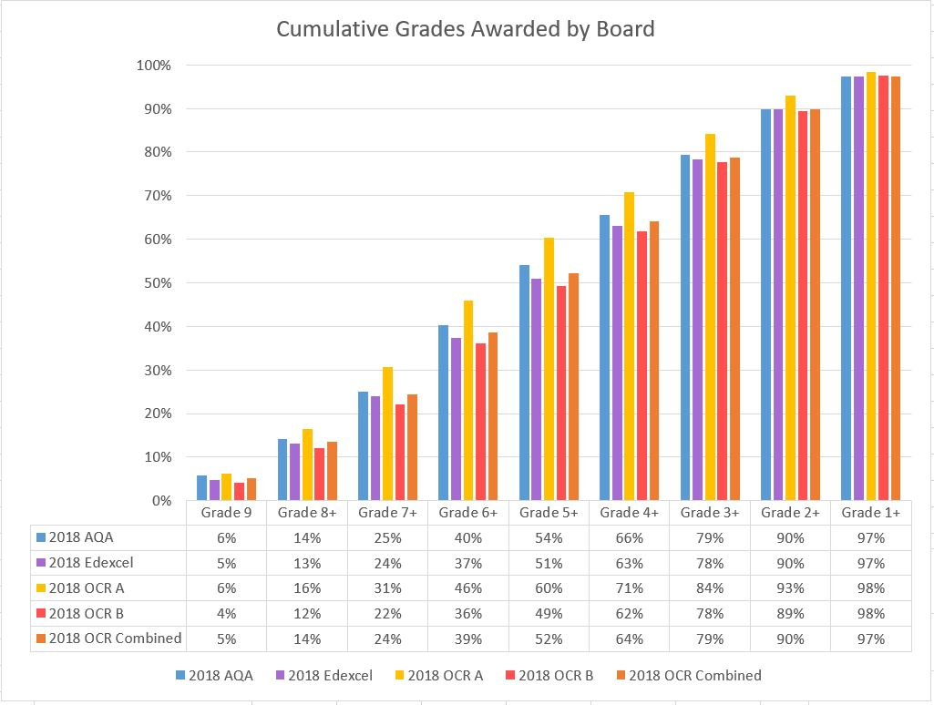
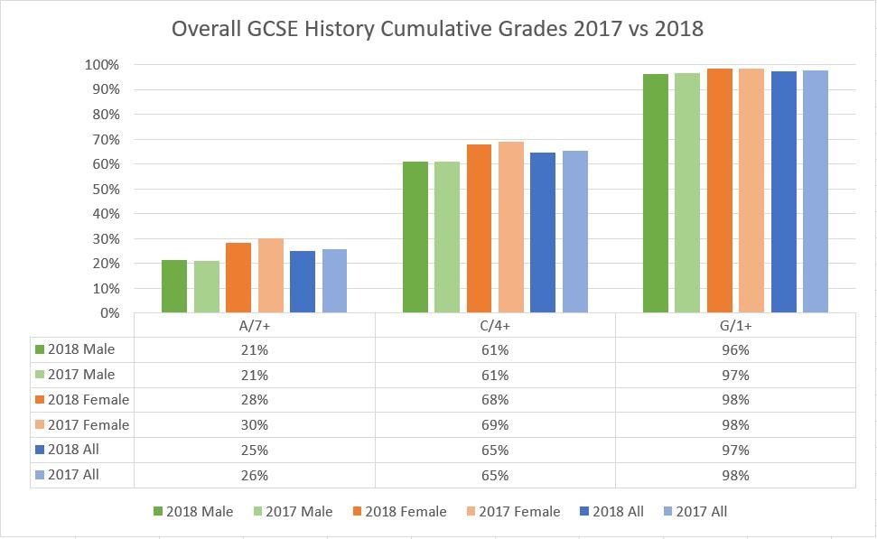
1. The overall results were as expected
Choice of board made no difference to results proportions nationally as results were tied to KS2 grades

Slide 11
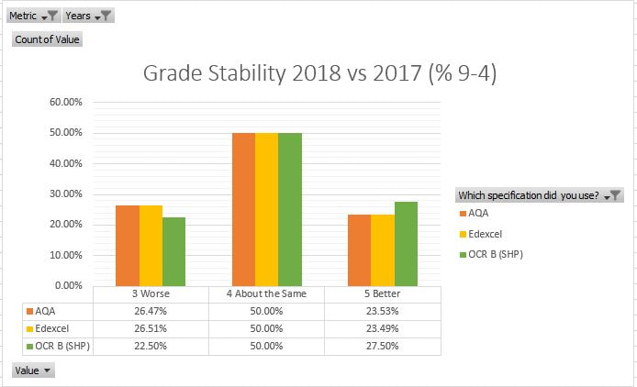
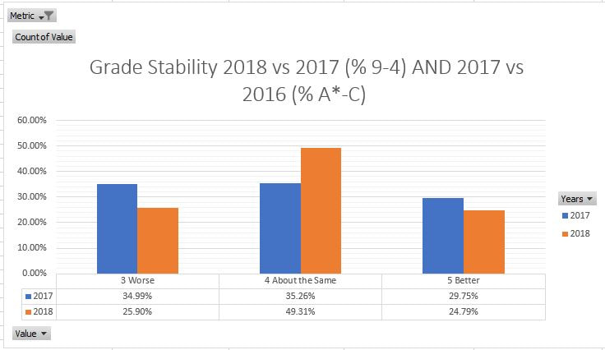
2. Grades were probably MORE stable this year
Survey data based on 363 schools

Slide 12
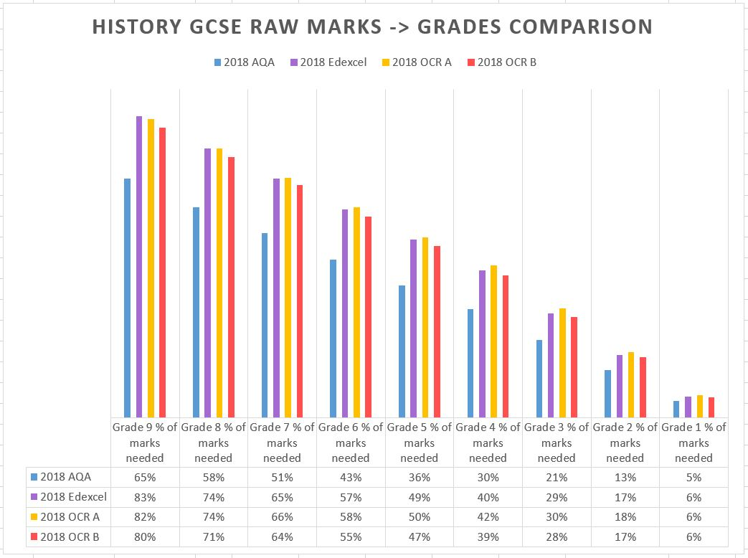
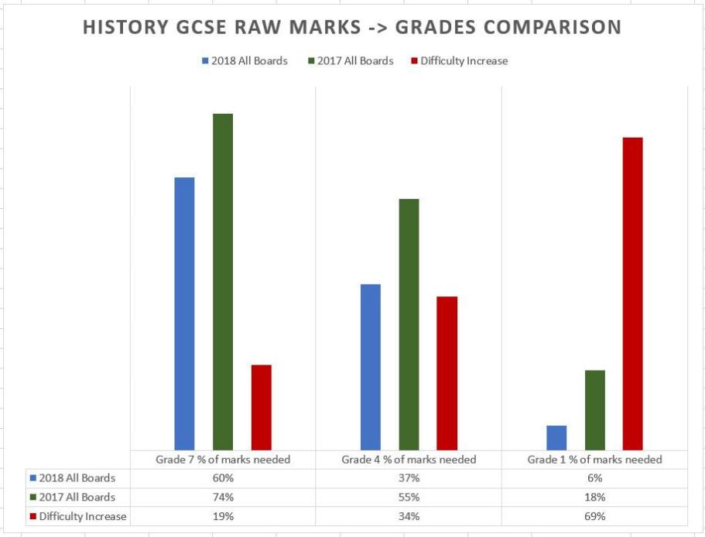
3. Pupils struggled much more with the new papers
A pupil who gained a Grade 1 probably only got around 10 marks in total over three papers. Or in other words, they answered only 1 complete question correctly in 3 papers and over 4 hours of exams. By contrast a pupil in 2017 was getting around 36 marks across their papers, and therefore answering at least 3 whole questions correctly.
Takeaway
Your top end pupils are probably fine with all the changes, but your weaker students are going to struggle.
Strategies to finish papers, or answer more questions will be key – confidence building and resilience work!
It will also be key to boost core knowledge so that more questions are accessible.

Slide 13
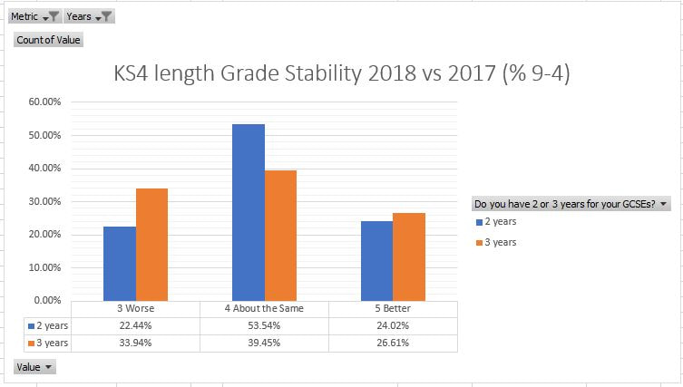
4. There is no evident benefit to a 3 year KS4
Takeaway
Although there are many reasons why a 3 year KS4 may not have worked well this year, there is a strong correlation between worsening results and the three year KS4 in lower attaining departments.
In other settings, the value of a 3 year KS4 currently seems questionable, though of course these is no way of knowing what impact keeping a 2 year KS4 would have had.
Survey data based on 363 schools

Slide 14
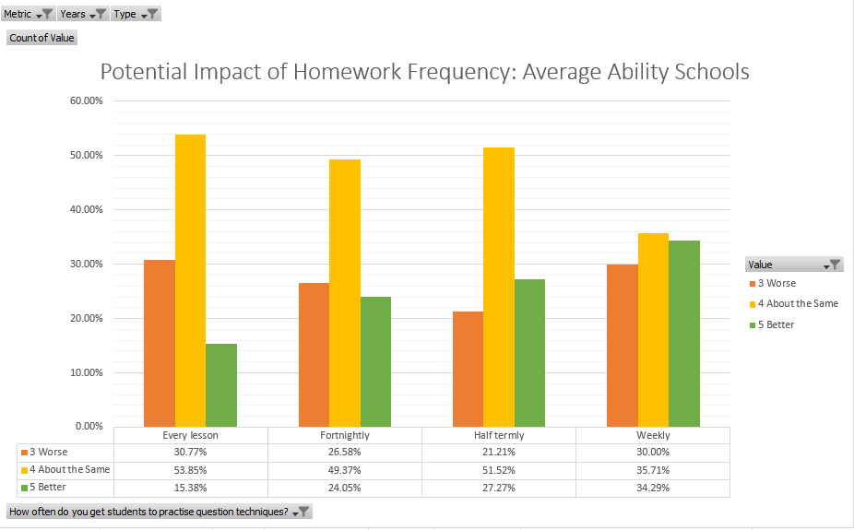
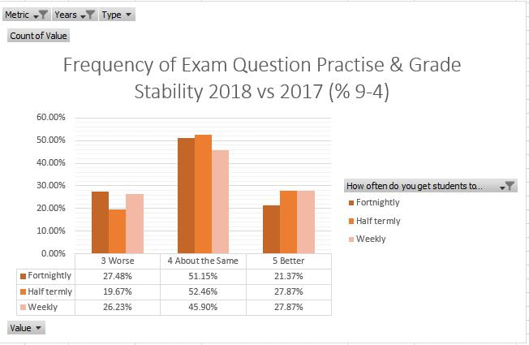
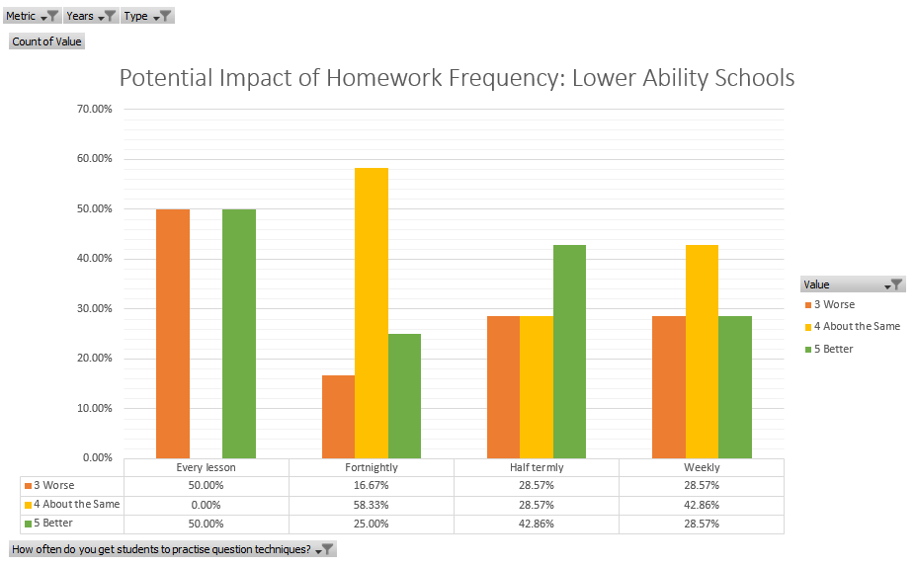
5. Hammering exam questions has very mixed results
Takeaway
Think carefully before bombarding your kids with loads and loads of exam practice questions – they may not really be helping. Sometimes grasping the content well, or doing something which builds confidence can be just as effective.
Also, if you are musing over a 3 year KS4, spending the extra time on loads of exam practise does not seem to be a great driver.
Survey data based on 363 schools

Slide 15
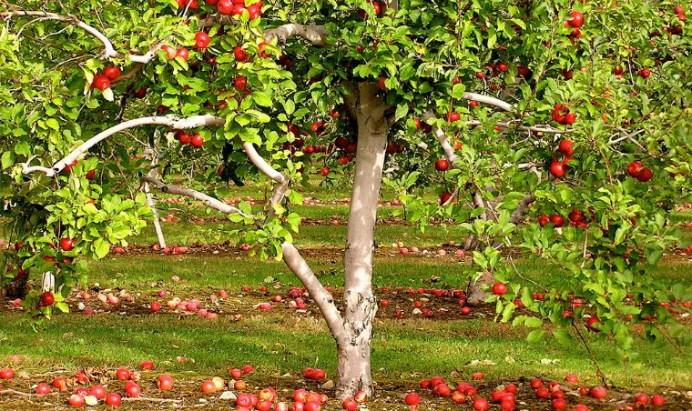



Big question: How can I improve success rates and consistency at GCSE?
This Photo by Unknown Author is licensed under CC BY-SA

Slide 16
Some thoughts from students (Burn & Todd, 2018)
Students believed GCSE was “harder now than it used to be” – an issue of reflected concern?
Students commented on course being rushed, repetitive and boring – an issue of curriculum
Students viewed the outcomes of history as “Remembering lots of information, lots of key facts.” – a paucity of explanations of purpose: the “because we have to” approach

Slide 17
Should I change board?
DON’T | DO
Don’t swap based on the number of 7s/4s awarded . Don’t swap to a board because it has lower grade boundaries. Don’t switch because you normally get better results. You might just need to understand the paper differently. | Do look closely at which specifications have the most appropriate content for your pupils. Do consider the weight of content in each specification and how this might turn into questions. Do look carefully at support networks and the quality of published resources for each spec. Do look closely at which questions are the best history. All boards have some hoop jumping, but some have more hoops than others.

Slide 18
What else could I do?
Read the examiners’ reports and compare this to the papers your pupils produced. Also request some standardised scripts.
Check your pupils were finishing papers and answering the questions set.
Rethink your planning at GCSE – were you overthinking legacy units? E.g. The People’s Health 1200-2000
Stick it out – stability is often key to success
RETHINK YOUR KS3……..

Slide 19
Success at GCSE is tricky but not complex
Exam success
Understanding how to “do” history (KS3!!)
Timing & rubric (easy)
Motivation to keep learning (Pedagogy)
Knowing the specific content
Having a broad hinterland (KS3!!)

Slide 20

Planting seeds
“Society grows great when old men plant trees in whose shade they will not sit.”
Greek Proverb (allegedly)
[N.B. I realise this is an Oak tree, but I like the picture]

Slide 21

The importance of the discipline
Students must have knowledge of the DISCIPLINE of history, its thought processes and methods to fully grasp it.
  e.g. how historians write about cause, generate claims about the past, interrogate sources etc.
BUT disciplinary constructs cannot exist apart from knowledge. They are entirely interdependent
Discipline
Teacher
Student

Slide 22
Curriculum: deriving from the discipline…
“The good historian is like the giant of the fairy tale. He knows that wherever he catches the scent of human flesh, there his quarry lies.” p22
“Conclusions which are founded upon a delicate imputation of motive fall upon a graduated scale from the infinitely probable to the barely credible.” p93
“Human actions are essentially very delicate phenomena…properly to translate them into words, to fathom them rightly…great delicacy of language and precision shadings of verbal tone are necessary.” p22
“…the knowledge of fragments, studied by turns, each for its own sake, will never produce the knowledge of the whole; it will not even produce that of the fragments themselves.” p128

Slide 23
Curriculum: Having clear aims (and sharing them)
Fascination with the living, breathing people of the past and how historians bring them to life
Having a broad outline of British (and other) history
Building a sense of identity
Understanding how historians search for truth in the past
The ability to engage critically with the world
Exam success, citizenship, opportunities etc.

Slide 24
Growing a powerful curriculum: how do we get there?
A curriculum shaped by the broader discipline: it’s processes and its collective knowledge
Engagement with the process of enquiry and the search for “truth” in the discipline
Detailed knowledge of the key topics covered e.g. the human stories behind the English Reformation
CURRICULAR GOALS
Broad, transferable, powerful knowledge which transcends topics e.g. the kinds of changes which the Reformation wrought
Engagement with the disciplinary lenses of history e.g. cause & consequence BUT applied to content

Slide 25

Planning a curriculum garden – be realistic

Slide 26
Setting out the key features: drawing on the discipline
Which fascinating little stories?
Which recurring ideas?
Which disciplinary ideas?
Which big stories?
Which key events / people?
e.g. authority, democracy, migration?
e.g. lynchpins: 1066? Peasants’ Revolt? Black Death?
e.g. the concept of liberty, the notion of an empire
e.g. SO concepts, enquiry etc.

Slide 27
Disciplinary history: implications for planning and teaching
Brings up key questions about knowledge e.g. if I want them to learn about the Norman Conquest:
  What are historians currently arguing about here?
  What disciplinary focuses are they taking?
  What knowledge would be powerful to include?
  How is it best to teach and test this knowledge?
  How will this topic support future topics and learning? What knowledge will be transferred?
  How will this be taught and assessed? Are GCSE questions actually the BEST way of assessing all of the above?

Slide 28
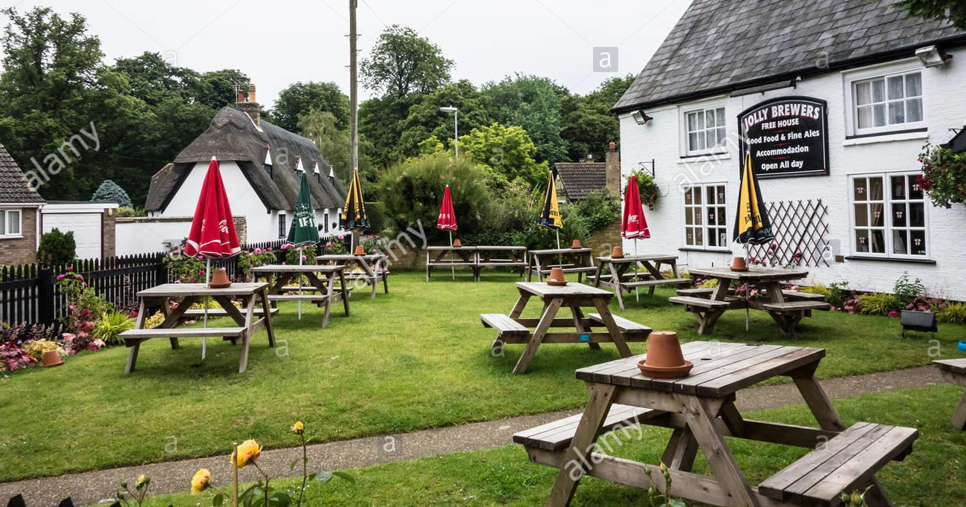

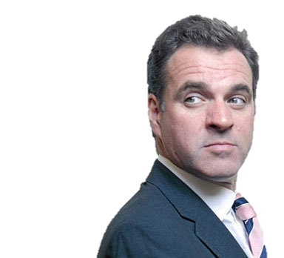

What kind of design is emerging?

Slide 29
How exactly did the Normans conquer England?
Was Edward I the ideal medieval king?
What mattered to people in the fourteenth century?
Could anyone control the church in the 15th century?
What should everyone know about the Black Death?
…
What connected the world in AD1000?
THEMATIC: When did people start caring about where they lived?
Who was really paying for Edward’s wars?
Why do historians still disagree about why people went on the First Crusade?

Slide 30
How can we secure knowledge over time?
What sorts of knowledge?
Which knowledge is going to have the most generative power?
Is it more than just “knowledge organisers” and quizzes
sense of period; detail; big stories; themes; substantive concepts?
this year, in KS3, across the Key Stages, in wider life?
Learning lists of facts by heart is probably the worst way to build understanding – we need to fascinate and help students puzzle about the past

Slide 31
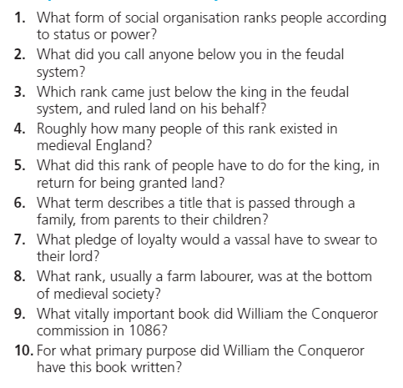
Are any of these important takeaways from a study of the Norman manorial system?
Peal, R. (2017) Knowing History: 1000-1500, Oxford

Slide 32
Considering what knowledge…
My key takeaways on the manorial system based on Crouch, Morris & Gillingham:
Norman rulers tried to use a system of land ownership and obligation to gain support and to keep order – it was oppressive (key to understanding later Enlightenment rejections of this system)
This system frequently broke down and led to bitter fighting between rivals (vital to understand why it began to dissolve in the 1400s)
Many “ordinary” people did their best to survive and thrive within these bounds, often bending and subverting the system (seeing people in the past as real!)
Methods to Embed
Short answer questions
  e.g. Give one way in which the manorial system helped the Normans keep control of England?
Extended answers / essays
A debate on the extent to which ordinary people were subdued by the Norman system
Scripted drama: the impact of the Normans on ordinary people

Slide 33
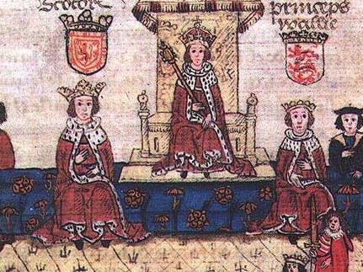
Who was paying for Edward I’s wars?
Based on Christopher Dyer’s “Making a Living in the Middle Ages” and Jeremy Goldberg’s “Medieval England: A Social History”
  Strong links between town and country economies
  An increasing focus on a money economy
  Kings / lords heavily dependent on “peasant entrepreneurialism”
Basic flow:
  Edward and his campaigns; The medieval economy; Developments in parliament
How England became wealthy; why towns grew (and became unhealthier); some LT causes of peasant discontent for 1381 / 1450
The bedrock of entrepreneurialism and non-barter systems which underpinned early exploration (EIC) and later Industrialisation.
Key tensions between kings / lords and people – plays out in 1381, 1450, Lollardy, Reformation, Civil War (?)

Slide 34
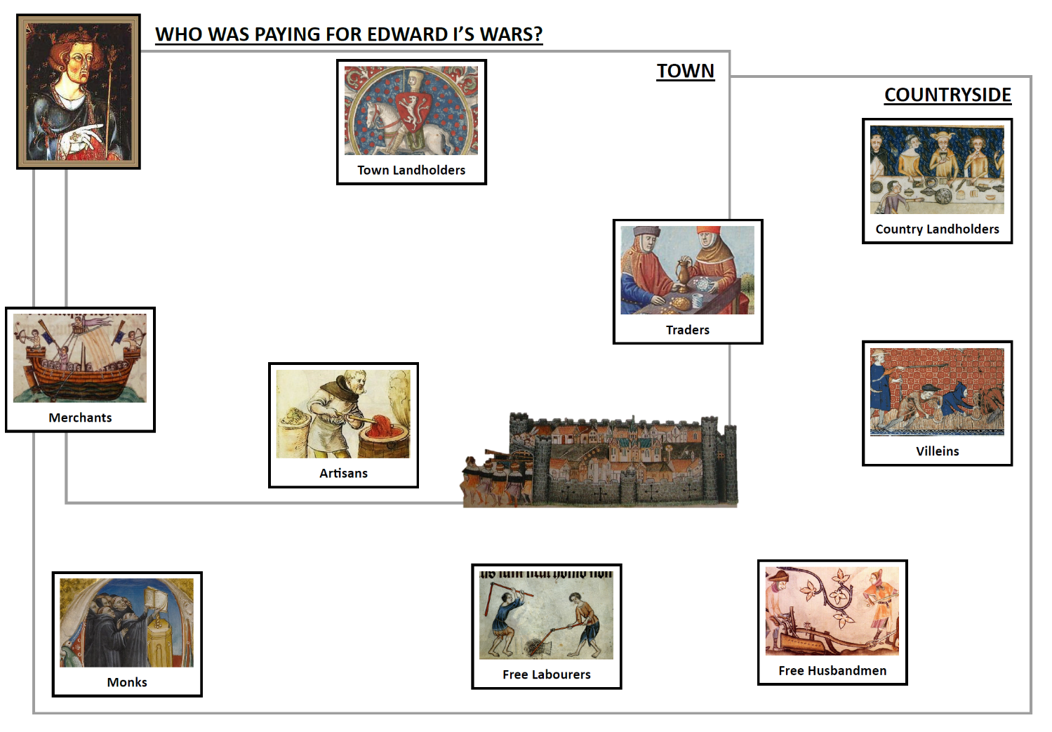
The biggest individual tax payers were the lords & merchants.
Add them to your diagram. Draw links to show where their money was going.

Slide 35
Towns saw a huge amount of wealth being created
Add the traders and artisans to your diagram. Draw links to show where the money was going.
Look again at the town landholders. Where is much of their money coming from?
Does town or country seem to be contributing most so far?

Slide 36
Trace the money coming to the big tax payers….
How did a villein’s work end up funding Edward’s wars?
What about other peasants?
Who was really paying for Edward’s wars?
Finally add on the people in the countryside

Slide 37
Securing concepts…
Big ideas:
  The nature of freedom in the Middle Ages
  Who was really making England rich
  How town and countryside were connected
  Factors creating wealth in the Middle Ages
  The complexity of medieval society & of the economy
  The privileges of the gentry, and especially of monks!!
Smaller ideas/knowledge:
  Differences between freemen, villeins, husbandmen and labourers
  The roles of merchants, artisans, traders etc.
  The notion of trade as being exchange of goods for cash.
  The notion of taxes, fees and fines
  Common goods being traded in the 13th century

Slide 38

Have fun & don’t forget GQT
andallthat.co.uk
@apf102

Slide 39
Useful reading on curriculum
Counsell, C. (2017) ‘The Fertility of Substantive Knowledge: In Search of Its Hidden Generative Power’. in Debates in History Teaching. Second Edition. ed. by Davies, I. London ; New York: Routledge, Taylor & Francis Group, 80–99
Gatto, J.T. (2010) Dumbing Us down: The Hidden Curriculum of Compulsory Schooling. Gabriola Island: New Society Publications
Hirsch, E.D. (2006) The Knowledge Deficit: Closing the Shocking Education Gap for American Children. Boston: Houghton Mifflin
Hirsch, E.D. (1999) The Schools We Need and Why We Don’t Have Them. 1. anchor book ed. Anchor books. New York: Doubleday
Kitson, A. (2017) How Helpful Is the Theory of Powerful Knowledge in the Context of History?
Young, M. (2014) ‘School Subjects as Powerful Knowledge: Lessons from History’. in Masterclass in History Education. ed. by Counsell, C., Burn, K., and Chapman, A. Masterclass in... Bloomsbury, 185–194
Young, M. (2007) ‘Curriculum Studies and the Problem of Knowledge. Updating the Enlightenment’. in Bringing Knowledge Back in: From Social Constructivism to Social Realism in the Sociology of Education. 81–92
Young, M.F.D. and Lambert, D. (2014) Knowledge and the Future School: Curriculum and Social Justice. New York: Bloomsbury Academic

Slide 40
Useful reading on the Middle Ages
Crouch, D. (2017) Medieval Britain, c.1000-1500, Cambridge University Press
Dawson, I. [Ed] (2018) Exploring and Teaching Medieval History, The Historical Association
Dyer, C. (2009) Making a Living in the Middle Ages: The People of Britain, 850-1520, Yale University Press
Gillingham, J. (2014) Conquests, Catastrophe and Recovery: Britain and Ireland 1066–1485, Vintage Books
Goldberg, J. (2004) Medieval England: A Social History 1250-1550, Hodder Arnold

