Slide 1
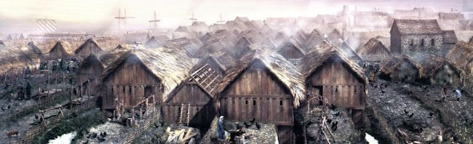
What sort of England did William conquer?

Slide 2

Anglo-Saxon England in 1066 was efficient, powerful, centralised and rich. This made it attractive to an invader and its lively, centralised, complicated politics led to weaknesses that made it vulnerable to invasion.
Professor Stephen Baxter, St Peter’s College, University of Oxford

Slide 3
You have a map and a family tree.
What can you infer about…
The connections of the Kings of England?
The way succession* worked at the time?
* Succession = who the throne passes to when a monarch (king or queen) dies.
How the people around York (Jorvik) may have been different to the people of southern England?

Slide 4
How can the surviving sources be used to support historians’ assertions?

Slide 5
What conclusions do historians draw from these sources?

Slide 6
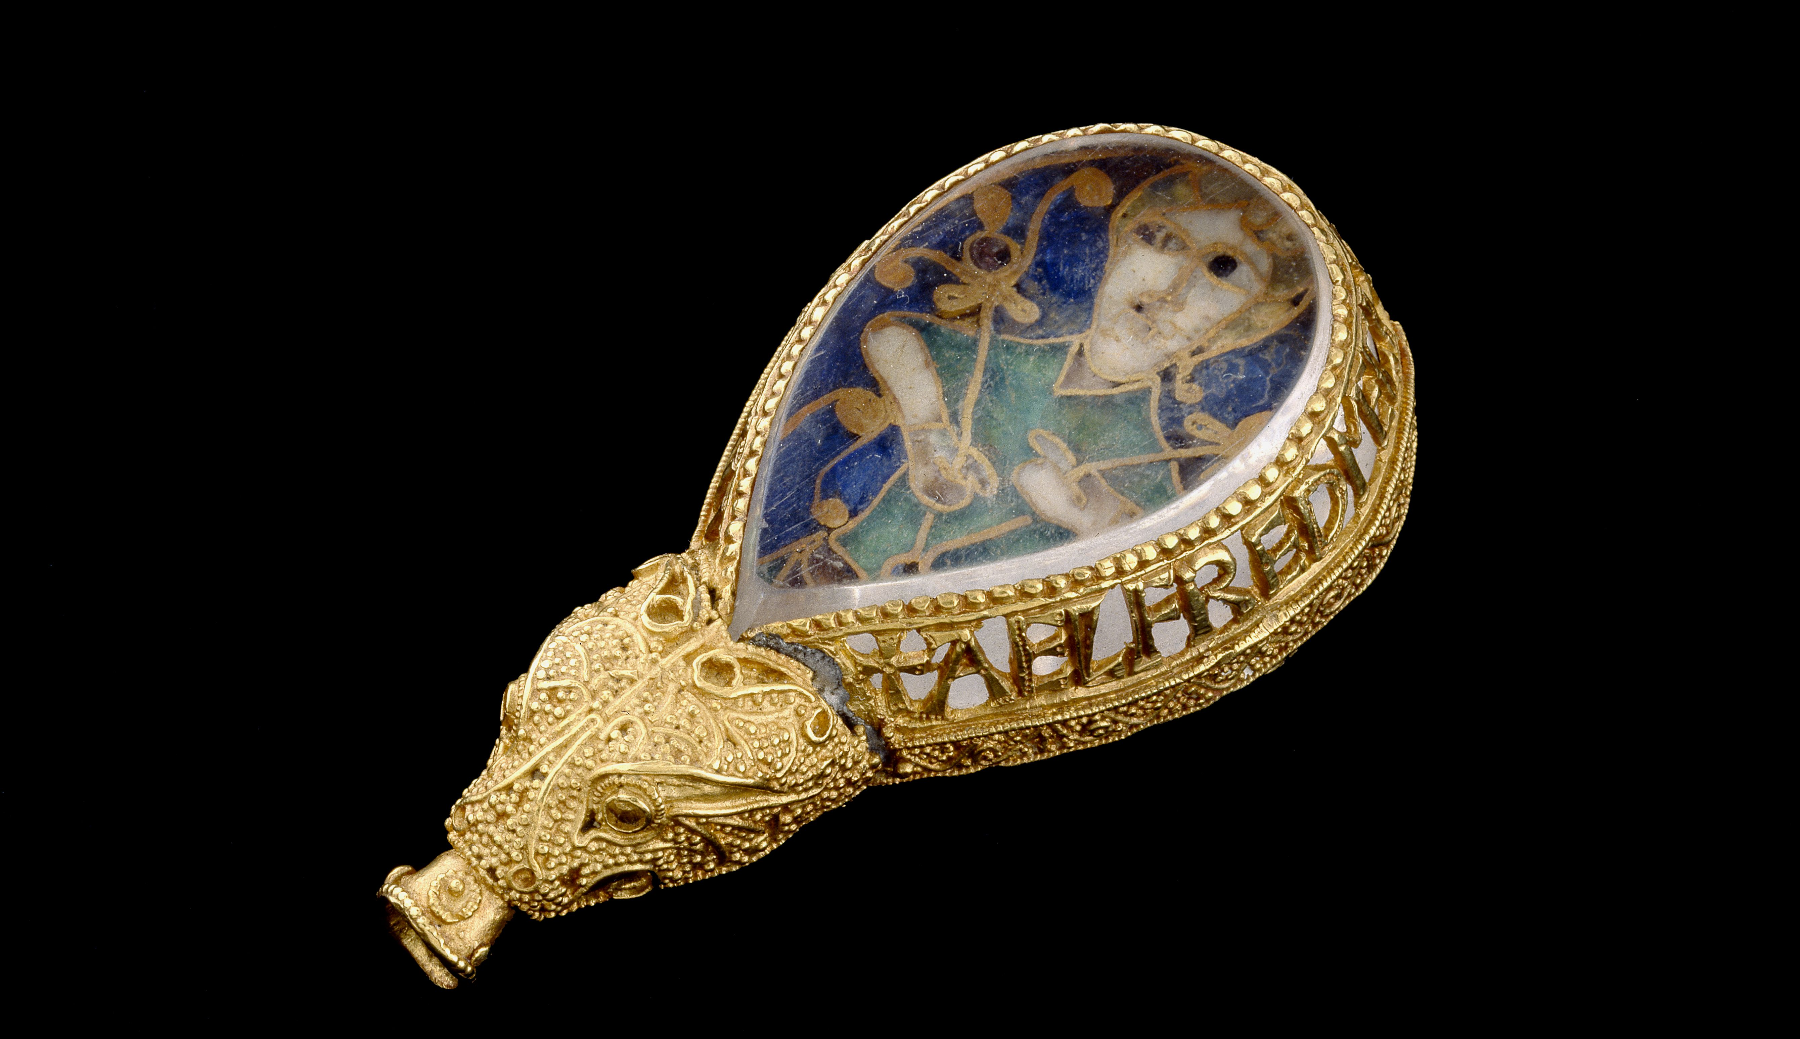
What sort of England did William conquer?

Slide 7
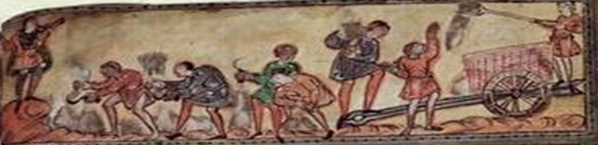
A few reading ideas…
James Campbell: ‘The Anglo-Saxon State’
James Campbell: ‘The Anglo-Saxons’
Henry Mayr-Harting: ‘The Coming of Christianity to Anglo-Saxon England’
Marc Morris: ‘The Norman Conquest’
Michael Wood: ‘In Search of the Dark Ages’

Slide 8
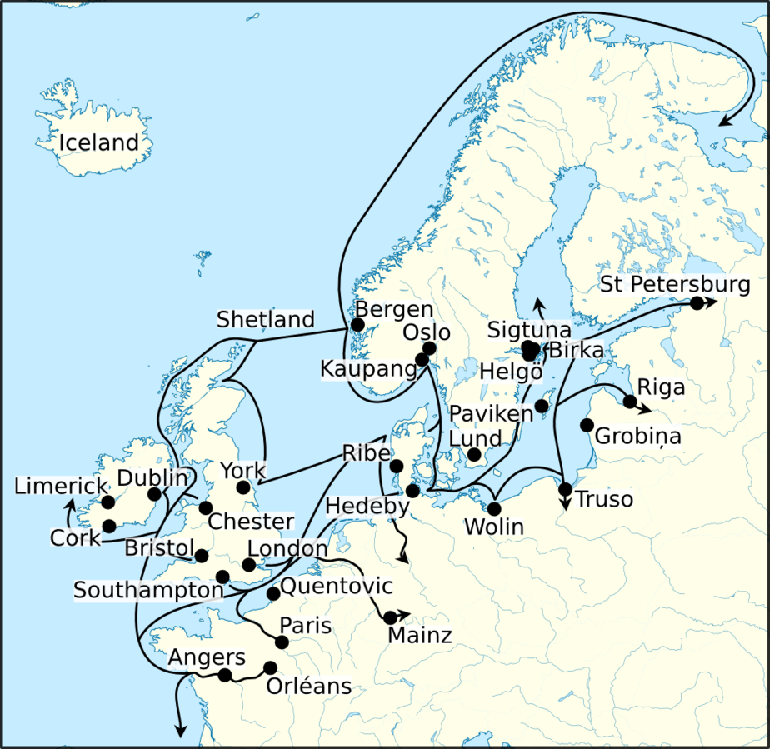

Trade routes
Scandinavia…
Norway
Denmark
How did people trade?
Which English cities were most important for trade with Scandinavia?
Which English people would have more links with Normandy?
Normandy

Slide 9
Kings of England 959-1066
Ethelred, King of England
978-1013 and 1014-1016
(succeeded his brother Edward who was King 975-8)
Canute, King of England 1016-35
(and King of Denmark and Norway)
Aelfgifu of Northampton
Swein, (King of Denmark) and King of England 1013-14
Emma of Normandy
Edward the Confessor, King of England
1042-1066
Aelfgifu of Jorvik (York)
Edmund Ironside, King of England
1016
Descendent Matilda would eventually marry King Henry I son of William the Conqueror, nephew of Emma of Normandy
Edgar, King of England 959-975
Harold I ‘Harefoot’, King of England
1035-40
Harthacnut, King of England (and King of Denmark)
1040-42
m1
m2
m1
m2

