Slide 1
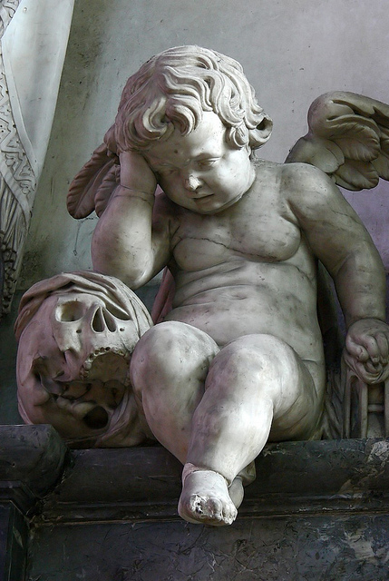
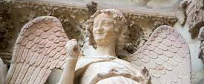
“Bumping into sources and asking (and answering?) intelligent questions about them.”
Using sources as evidence without death by exam question!

Slide 2
Seems to hinge around the meaning of…
Developed understanding
Complex understanding
Sustained judgement

Slide 3
The high-achievers with sources…
Really secure topic, period and wider knowledge

Slide 4
How useful is source A to a historian studying Oliver Cromwell?
A framework chronology of his life – including where was he when?
Detailed story knowledge of his role in developing the New Model Army, defeat of Irish Catholics, role at the trial of the King, role as Lord Protector, actions in and against Parliament.
Conceptual understanding of: parliamentary sovereignty, divine right of kings, Puritan, Lord Protector, republic, Major General, civil war, Interregnum, revolutionary thought.
Sense of period: including structure of society in the 17th century, importance of religious belief to all aspects of life.
Sense of person: what/who motivated and inspired and annoyed him? His beliefs? His friends/enemies?
Reputation: at the time and since (the marmite factor!)
http://www.top10trails.com/yorkshire-wolds-way/4

Slide 5
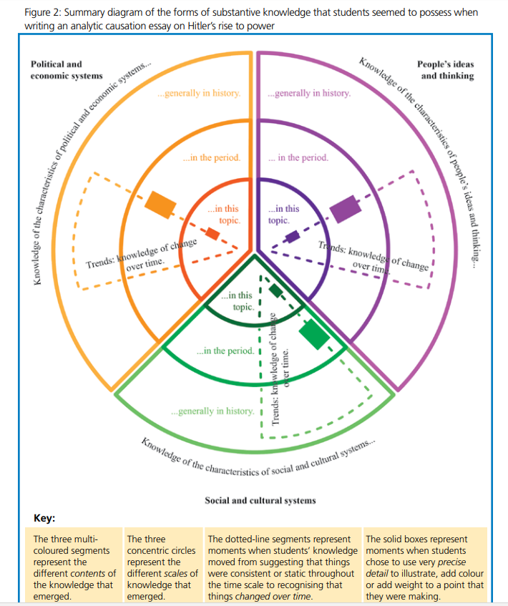
Three scales of knowledge:
TOPIC
PERIOD
WIDER

Slide 6
Y7 to Y8 to…
Topic
Period
Wider

Slide 7
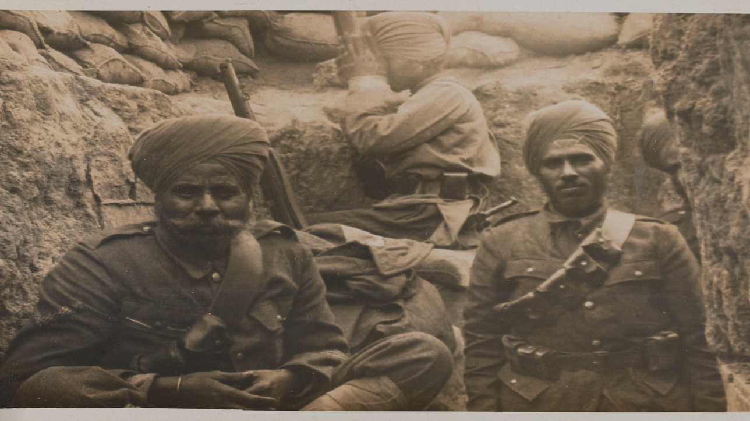

Slide 8
The high-achievers with sources…
Really secure topic, period and wider knowledge
Working as a historian with sources to use them as evidence as part of a disciplinary enquiry

Slide 9
Sharpening up how we talk about sources and evidence
SOURCES ARE NOT EVIDENCE!

Slide 10
Sharpening up how we talk about sources and evidence
A source is a remnant of the past – something that has survived
Sources can be categorised: textual, artefacts, images, archaeological
On their own they say ‘nothing beyond the fact of their own existence and their own survival’.
Examples: a photograph of a pre-First World War picnic, a pot from Jorvik, a Nazi propaganda poster, Charles I’s death warrant

Slide 11
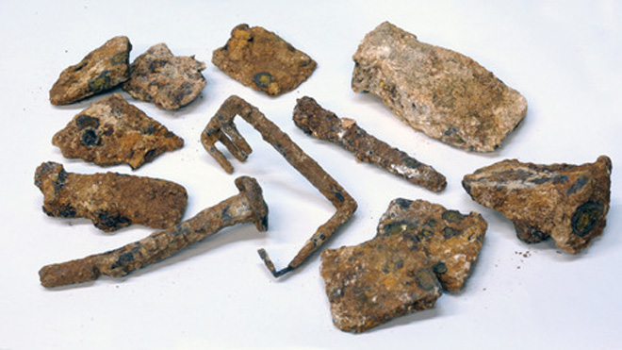
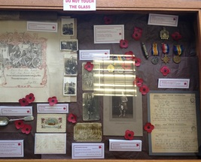
Talking about sources and evidence
Evidence is a concept
A source becomes evidence when it is interrogated for a purpose
Year 7 exam Q:
Describe the stages from an artefact being discovered to it becoming part of a museum display?

Slide 12
Sources used as evidence for enquiry
How valuable is Source M for understanding the role of women in the First World War?
How useful are sources P and S for a historian studying the reasons for the Break with Rome?
What can the source tell us about the Battle of Waterloo?

Slide 13
https://www.hist.cam.ac.uk/prospective-undergrads/virtual-classroom/primary-source-exercises/sources-wars-roses
Give lots of contextual knowledge first (topic, period and wider)
Hefty contextualisation of individual sources
Encourage tentative answers
Ask interesting topic specific questions about the source material that are nevertheless highly disciplinary
Develop the complexity as the enquiry proceeds
Do not pretend that all conclusions are equally valid – instead focuses on the quality of the evidence for assertions

Slide 14
The high-achievers with sources…
Really secure topic, period and wider knowledge
Working as a historian with sources to use them as evidence as part of a disciplinary enquiry
Highly literate in a way that allows them to structure their thinking and articulate their thoughts

Slide 15
Misconception: Sources are easy to interpret
Reach for:
Monty Python! https://www.youtube.com/watch?v=Ww06W9N8prc

Slide 16
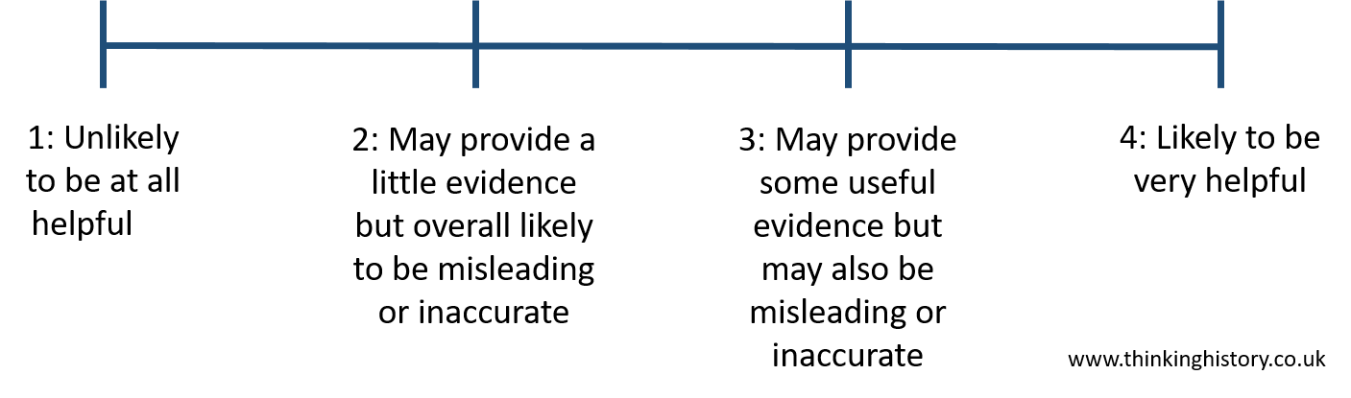
Misconception: ‘Sources can give one true answer!’
Reach for:

Slide 17
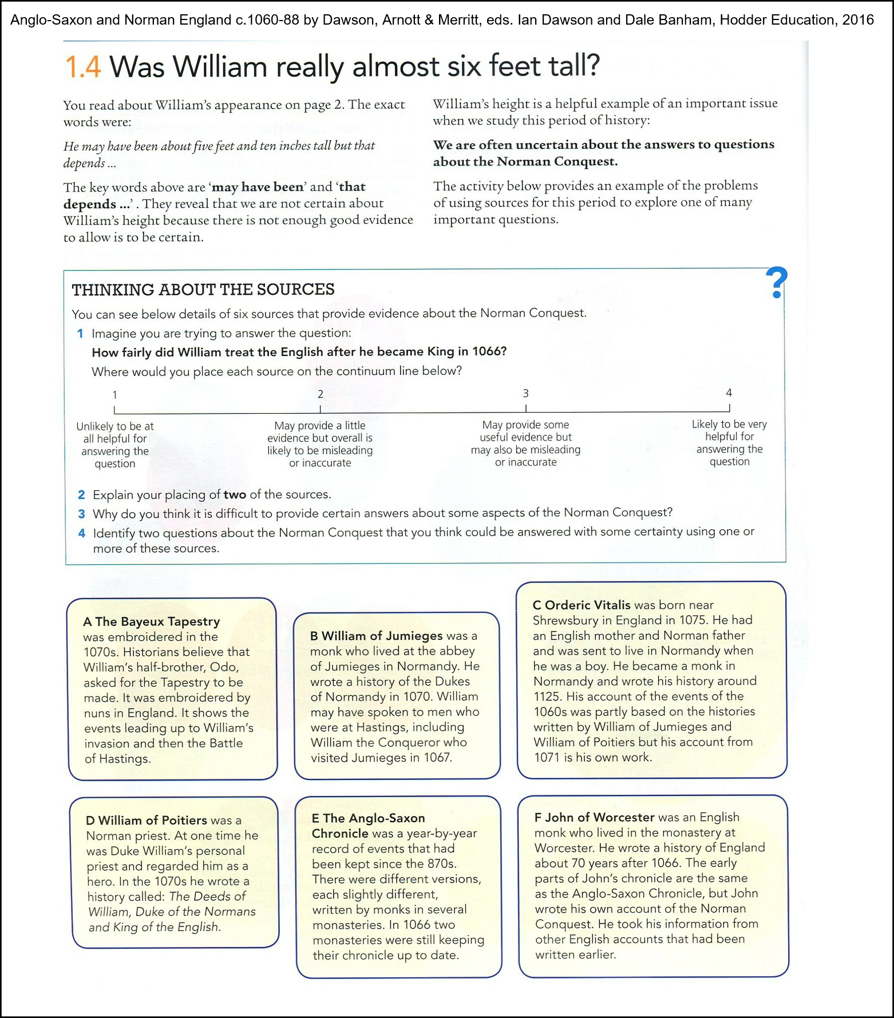
Misconception: ‘Sources can give one true answer!’

Slide 18
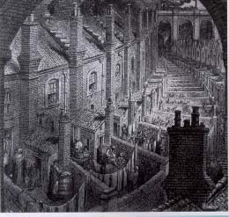
Interrogating sources with inference diagrams.
How can I check I am right?
What
What can I infer about life in a Victorian city?
What can I see?

Slide 19
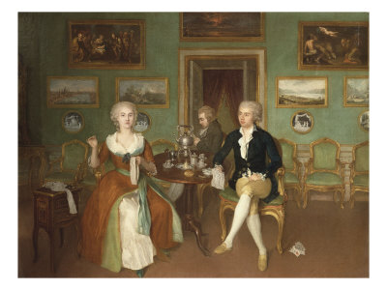
How does your new knowledge help you to understand this picture?
What would you like to know about what you can see in the picture?
What can you see in the picture?

Slide 20
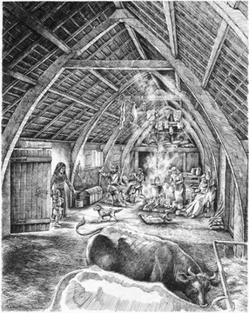
What do you think the archaeologist showed and told the artist?
What does the artist show us?

Slide 21
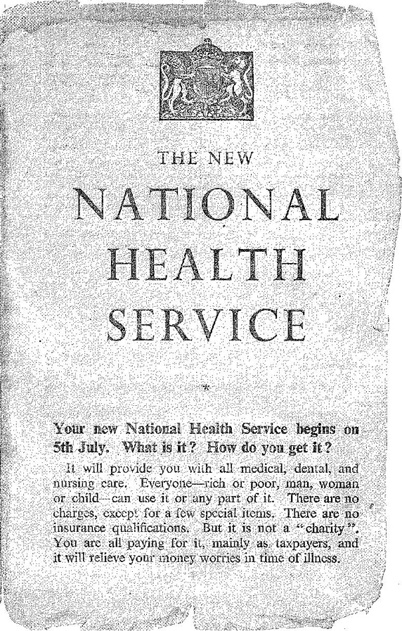


This leaflet was sent to every home in England in 1948. It was produced by the government to inform people about the new NHS. At the end of each arrow, add a piece of knowledge that puts what you are reading in the leaflet into context.
Ways the tone of the source links to its purpose:

Slide 22
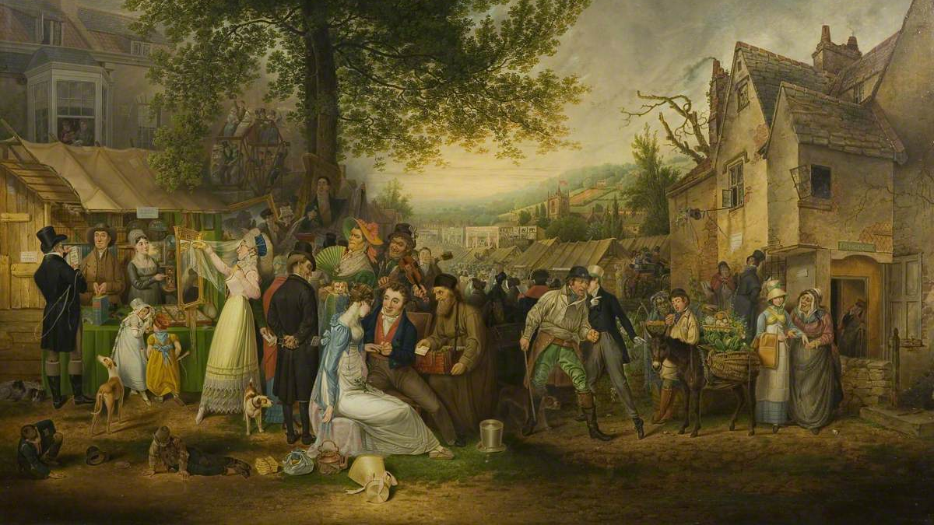

Slide 23
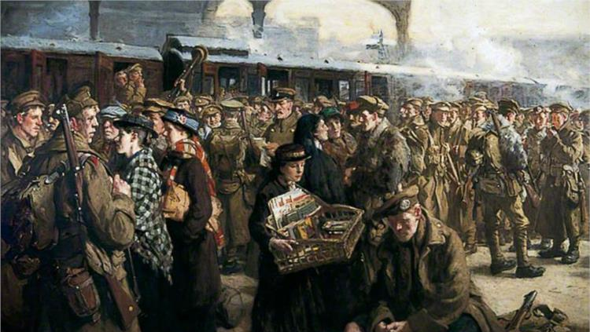

Slide 24
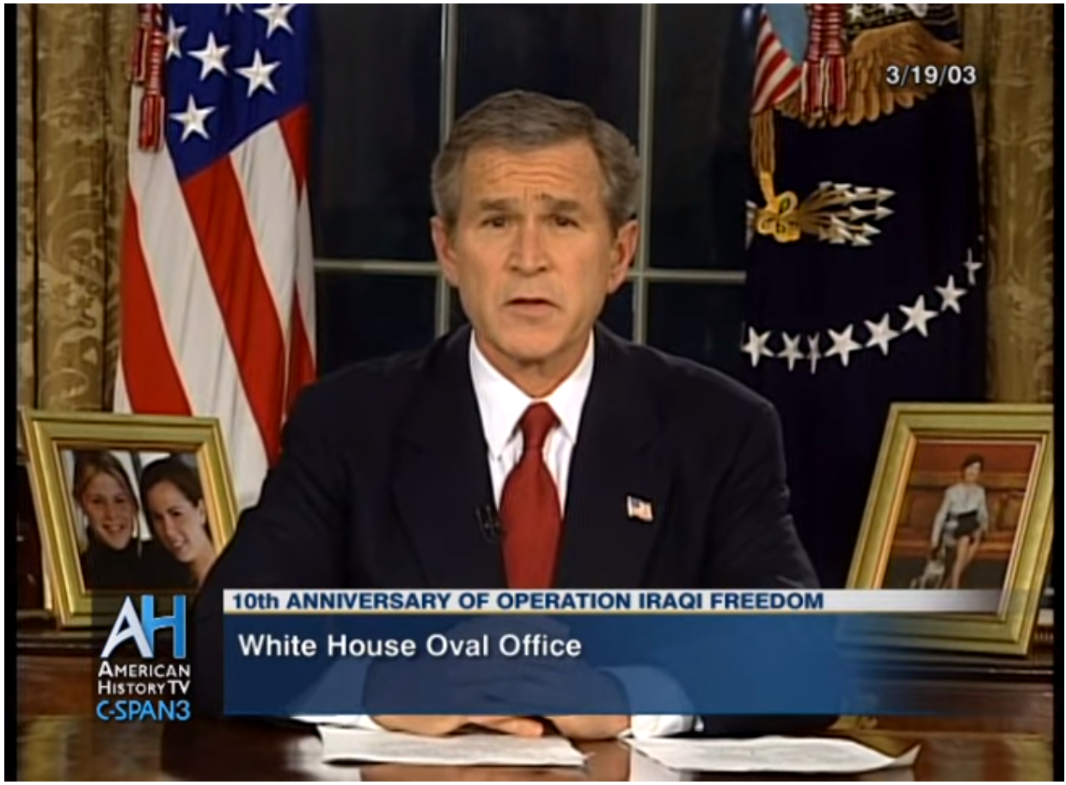
Use of longer text…
https://www.youtube.com/watch?v=5BwxI_l84dc
https://www.theguardian.com/world/2003/mar/20/iraq.georgebush

Slide 25
What is the historical context to this speech?
This election had many firsts and many stories that will be told for generations. But one that's on my mind tonight's about a woman who cast her ballot in Atlanta. She's a lot like the millions of others who stood in line to make their voice heard in this election except for one thing: Ann Nixon Cooper is 106 years old.
She was born just a generation past slavery; a time when there were no cars on the road or planes in the sky; when someone like her couldn't vote for two reasons -- because she was a woman and because of the color of her skin.
And tonight, I think about all that she's seen throughout her century in America -- the heartache and the hope; the struggle and the progress; the times we were told that we can't, and the people who pressed on with that American creed: Yes we can.
At a time when women's voices were silenced and their hopes dismissed, she lived to see them stand up and speak out and reach for the ballot. Yes we can.
When there was despair in the dust bowl and depression across the land, she saw a nation conquer fear itself with a New Deal, new jobs, a new sense of common purpose. Yes we can.
When the bombs fell on our harbor and tyranny threatened the world, she was there to witness a generation rise to greatness and a democracy was saved. Yes we can.
She was there for the buses in Montgomery, the hoses in Birmingham, a bridge in Selma, and a preacher from Atlanta who told a people that "We Shall Overcome." Yes we can.
A man touched down on the moon, a wall came down in Berlin, a world was connected by our own science and imagination.
And this year, in this election, she touched her finger to a screen, and cast her vote, because after 106 years in America, through the best of times and the darkest of hours, she knows how America can change.
Extract of President Barack Obama’s acceptance speech, November 2008

