Slide 1
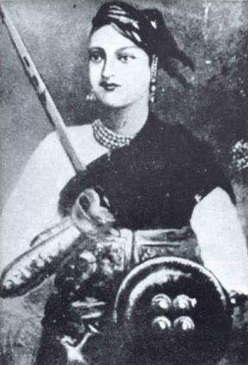
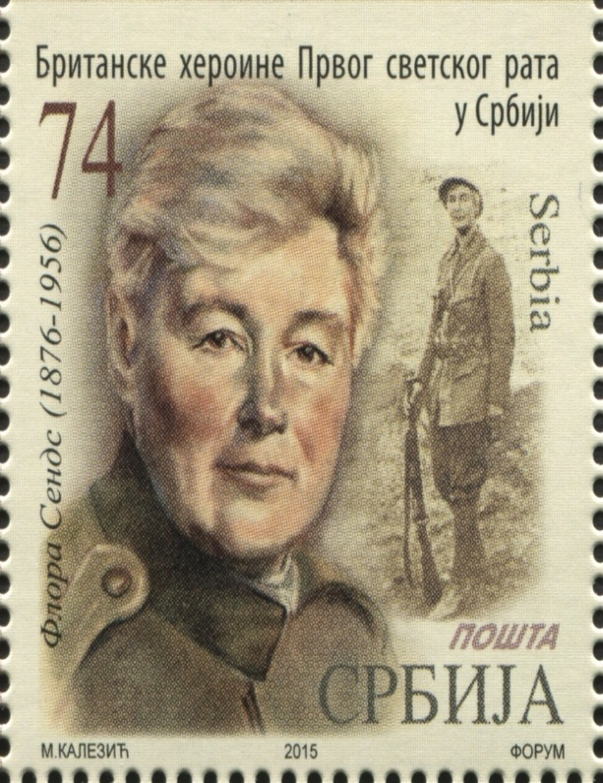
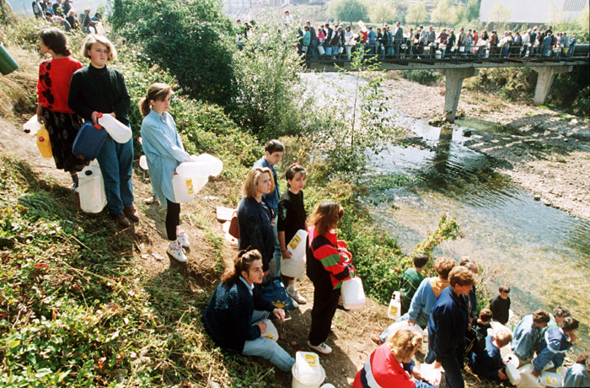
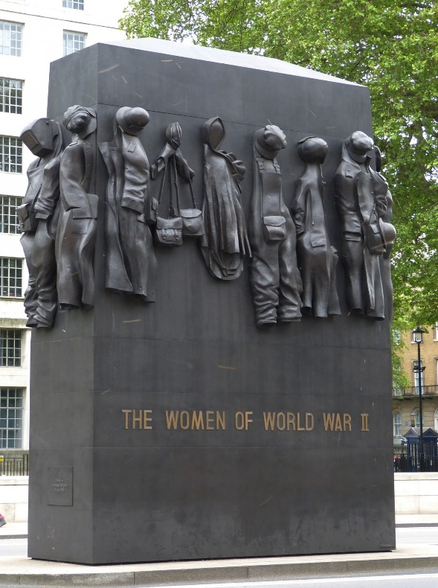
Women in war over time

Slide 2
British women in war over time – a thematic activity
You have cards about British women in war over time.
Sort them into time order and read them.

Slide 3
British women in war over time – a thematic activity
You have cards about British women in war over time.
Sort them into time order and read them.
Now decide some headings and organise the cards under your headings
  Examples: fighters, nurses…

Slide 4
British women in war over time – a thematic activity
You have cards about British women in war over time.
Sort them into time order and read them.
Now decide some headings and organise the cards under your headings
  If you were a lower attaining group we would have said: “Add a post-it wherever you can find women taking the following roles:
    Fighters,
    Nurses and carers
    Peacemakers
    Homemakers
    Military leaders
    Supporting roles in the armed forces”

Slide 5
British women in war over time – a thematic activity
You have cards about British women in war over time.
Sort them into time order and read them.
Now decide some headings and organise the cards under your headings
The bigger picture: what can we infer about women and society in Britain across time?

Slide 6
