Slide 1
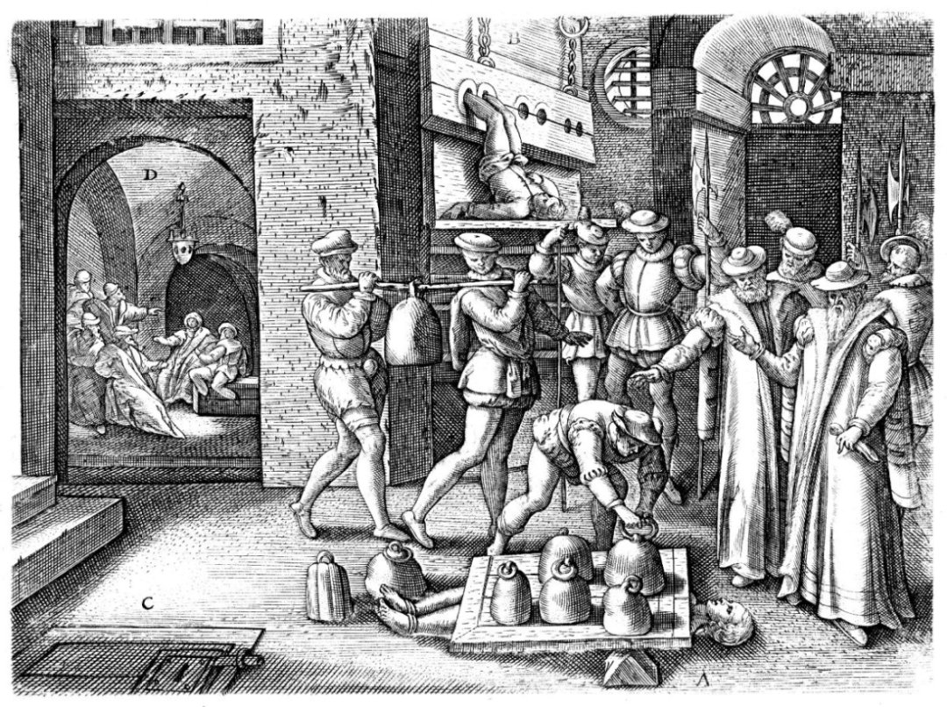
STARTER
This shows the execution of Margaret Clitheroe, from York, in 1586.
What does the engraving tell you about the religious situation in England in the 1580s?
Challenge: How can you link this to your prior learning about religion in England?

Slide 2
What can Margaret Clitheroe tell us about religion in the 1580s?
Describe the life of Margaret Clitheroe.
Look at the broader picture of religion in the 1580s.
Apply Clitheroe’s story to understand the consequences of Elizabeth’s religious changes.

Slide 3
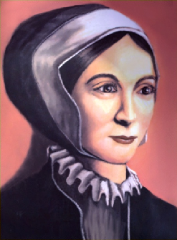
MARGARET CLITHEROE’S LIFE
Born in 1556 as Margaret Middleton, Margaret lived a relatively comfortable life growing up. Her father was the Church Warden for St Martin’s Church in Coney Street, as well as being a respectable businessman.
She did not learn to read or write growing up; aged 15, she married local butcher, John Clitheroe, who lived and worked on the Shambles.
Shortly after her marriage, Margaret was converted to Catholicism. This was likely done by the wife of prominent Catholic, Dr Thomas Vavasour. This was a particular problem for Margaret as her husband was responsible for reporting Catholic worshippers in their parish…
Notes:
Recall questioning: Who was monarch in 1556? What religion was she?
Broader contextual questioning for York: Where is Coney Street / what is on it now? Where are the Shambles?

Slide 4
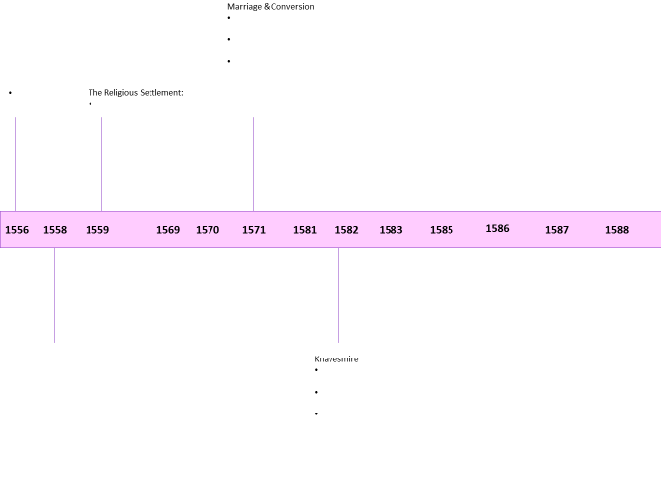
MARGARET CLITHEROE’S LIFE
Use the two page summary you have of Margaret’s life to complete the timeline. Parts may already be done for you.
Challenge: What other events can you add onto the timeline?
Notes:
Use the slot in for this activity. Some of the dates cannot be completed; they are for the broader context activity after this.

Slide 5

REVIEW
Verbally summarise the life of Margaret Clitheroe. They will give you a RAG rating and tell you how to improve your answer.
Then swap…
Challenge: How can you link this into the broader developments of the time?
Notes:
Model what a R/A/G answer would look like

Slide 6
THE BROADER CONTEXT
Continuing to use the two page summary, add details for the other dates on the timeline. Please use a different colour → this is called the context.
Challenge: Why was Clitheroe willing to risk the consequences of breaking Elizabeth’s religious laws?
Notes:
Use the slot in for this activity.

Slide 7
CONSEQUENCES
What does Clitheroe’s story tell us about the consequences of religious issues in Elizabethan England?
Ensure you bring in the broader context into your answer.
Challenge: How can we categorise these consequences?
Notes:
Use the slot in for this activity.

Slide 8
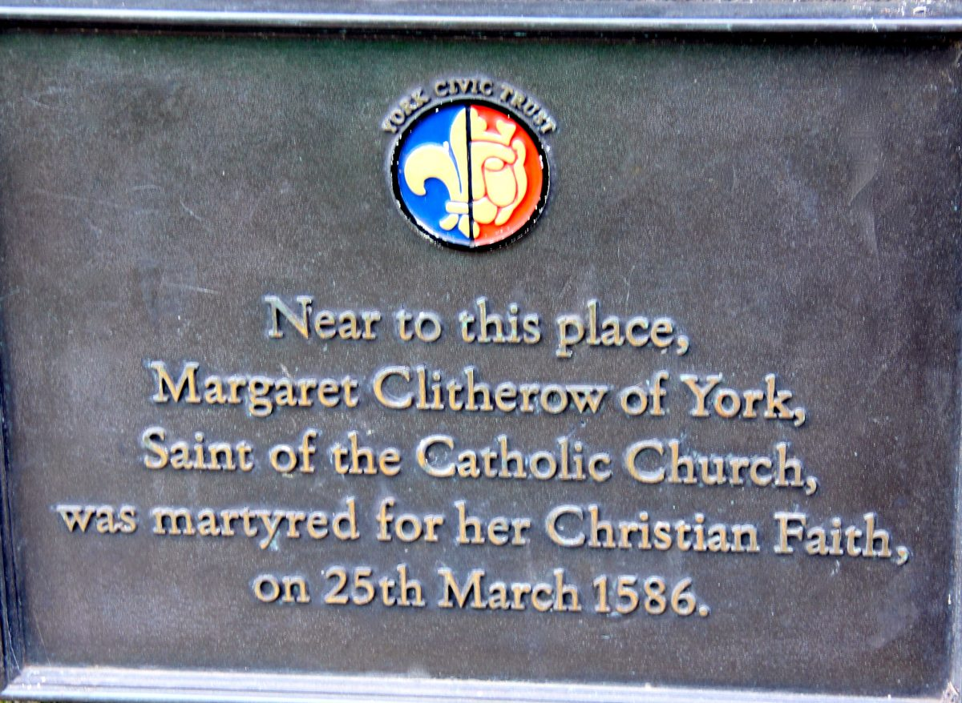
COLLECTIVE MEMORY
What does this plaque suggest about the memory of Margaret Clitheroe in York?
What does this suggest about the power of her story?

Slide 9

PLENARY
Summarise today’s learning onto a post-it note.
Challenge: How did Clitheroe’s story change York? Or did it?

