Slide 1
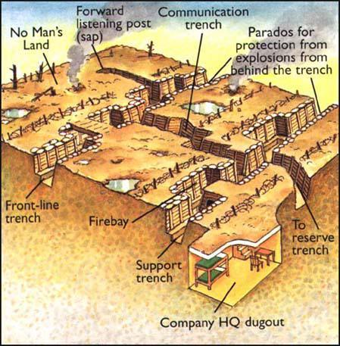
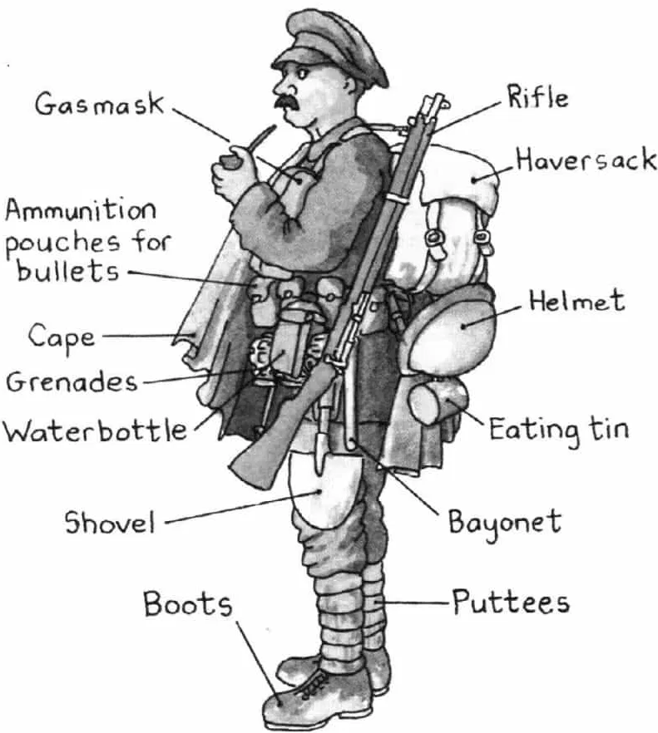
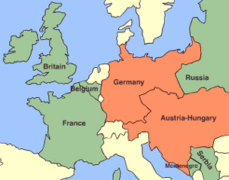
Vocabulary
Trench System
British Equipment
Key Countries
Armistice – agreement to stop fighting.
Artillery – heavy, wheeled guns that fire large explosive shells.
Assassination – the murder of a public figure.
Blockade – using warships to stop a nation from trading by sea.
Civilian – a person not involved in fighting.
Conscription – compulsory military service.
Enlist – join the armed forces (“join up”).
No Man’s Land – the area between the two opposing trenches which is unoccupied.
Neutral – not choosing a side.
Offensive – an attacking military campaign.
Shell shock – a mental disorder caused by exposure to warfare.
Stalemate – neither side being able to move forward.
Trench warfare – fighting based in trench systems, in which neither side can gain the advantage.
U-Boat – German term for a submarine.
War of attrition – when both sides fight until one side has no more men or resources to give.
Western Front – the area in France and Belgium where fighting took place.
Assassination of Archduke Franz Ferdinand
German invasion stopped at the First Battle of the Marne – start of trench warfare
Ottoman Empire enters the war on Germany’s side
Poisonous gas first used
Allies land in Gallipoli
Lusitania passenger boat sunk by German U-boat
Conscription introduced in Britain
Battle of Jutland
Battle of the Somme starts
Tanks used for the first time
USA enters the war
Third Battle of Ypres (Passchendaele) starts
Russian officially leaves the war.
German Ludendorff Offensive begins
Allied Hundred Days Offensive begins
The Armistice is signed
28th June 1914
6th – 9th
September
1914
29th October
1914
22nd April 1915
25th April 1915
7th April 1915
27th January 1916
31st May 1916
1st July 1916
15th September 1916
6th April 1917
31st July 1917
3rd March 1918
21st March 1918
8th August 1918
11th November 1918
Allies
Central Powers
Neutral
USA
April 1917
Ottoman Empire
October 1914
THE FIRST WORLD WAR (1914 –1918)
Or, World War One, WW1, The Great War
Timeline

Slide 2
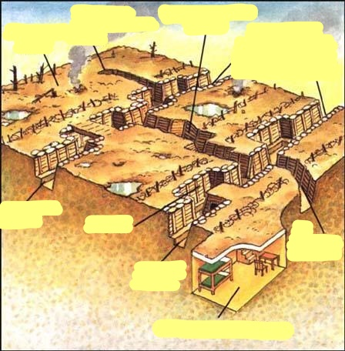
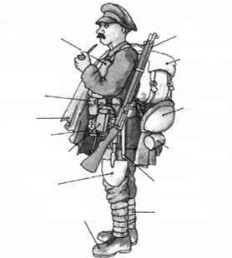
Vocabulary
Armistice –
Artillery –
Assassination –
Blockade –
Civilian –
Conscription –
Enlist – (“join up”)
No Man’s Land –
Neutral –
Offensive –
Shell shock –
Stalemate –
Trench warfare –
U-Boat –
War of attrition –
Western Front –
First World War –
Great War -
28th June 1914
6th – 9th
September
1914
29th October
1914
22nd April 1915
25th April 1915
7th April 1915
27th January 1916
31st May 1916
1st July 1916
15th September 1916
6th April 1917
31st July 1917
3rd March 1918
21st March 1918
8th August 1918
11th November 1918
USA
April 1917
Ottoman Empire
October 1914
THE FIRST WORLD WAR (1914 –1918)
Or, World War One, WW1, The Great War
Timeline

