Slide 1
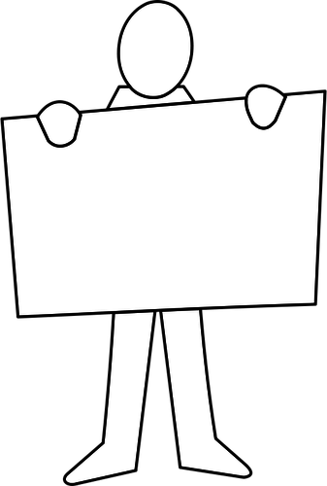
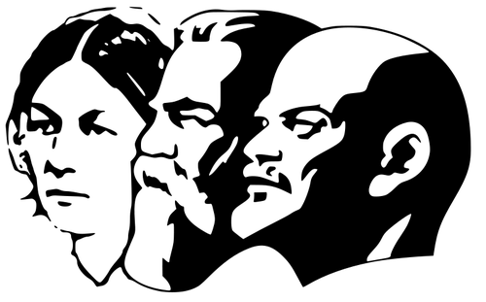


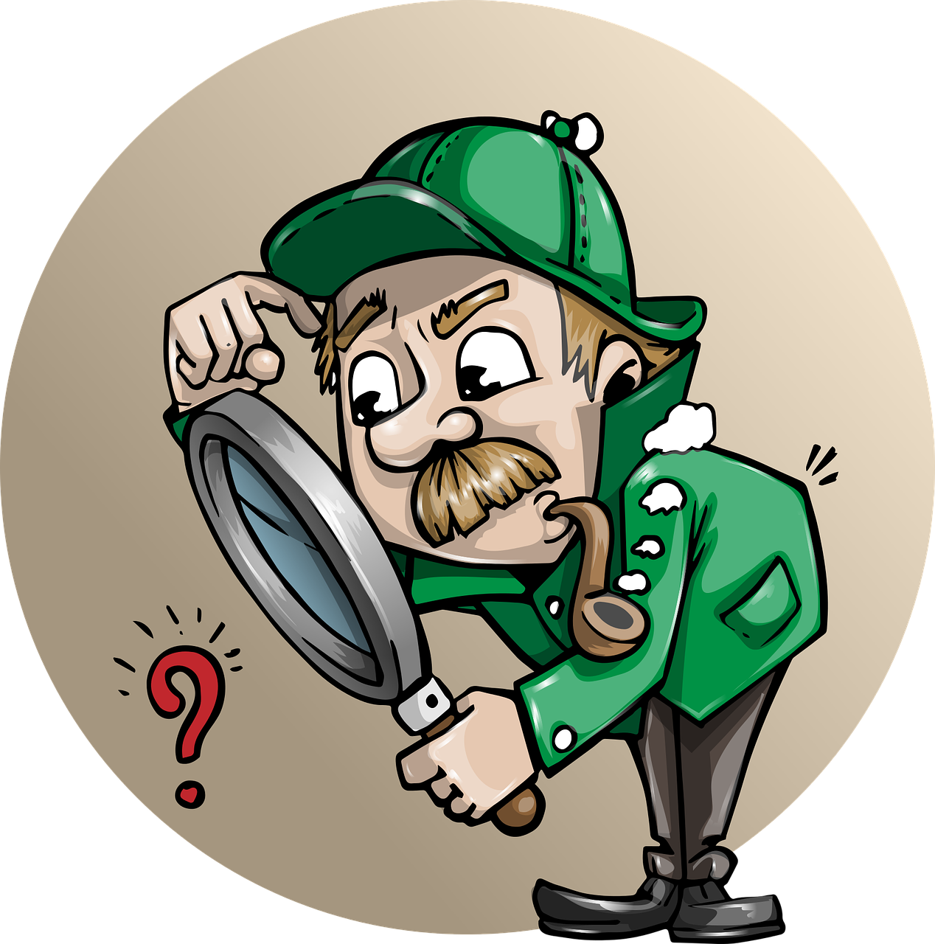

STUDYING
HISTORY
Why do we study history?
Who does the knowledge of the past belong to?
What is history?
What makes a good historian?

Slide 2
Key words
What is history?
If you get stuck come back to this once you have completed the booklet.
Put simply… History is the study of the past. It is the study of stories of mankind.
How do we find out about the past?
Who owns history? Who does the knowledge of the past belong to?
Why are certain people telling us certain things about their story?
The stories we have access to are not necessarily the facts of the past – historians must think really carefully about the information they have to try to construct the best possible version of what happened evidence.
We call these interpretations in history – a person’s view of the past.
History
Historian
Interpretation
Chronology
Primary source
Secondary source
A source made after the event used to assess the event
A person’s evidenced viewpoint of the past
The study of past events
Putting events or dates in order of when they happened
An expert on certain topics of history
A source is a written or produced at the time
1
2
Match the words to the definitions!

Slide 3
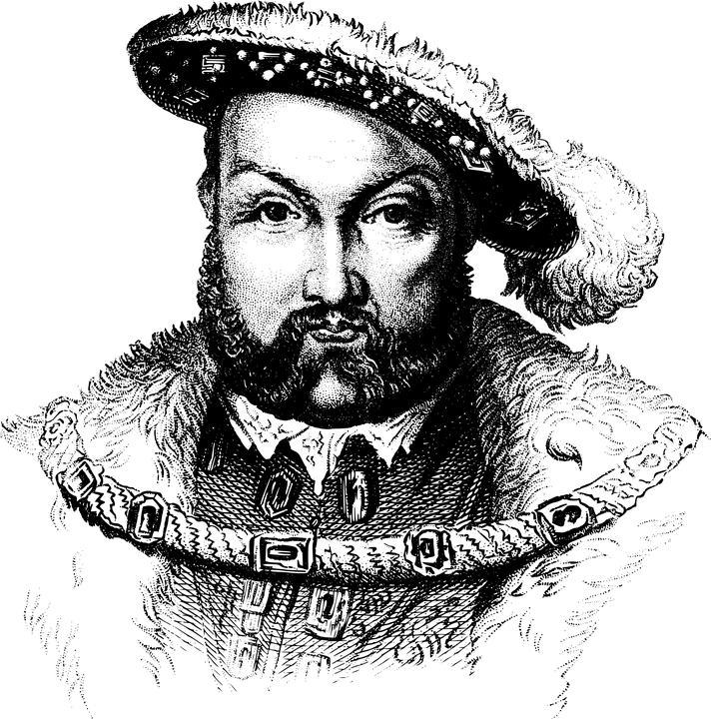
How well do you
know your history?
Did you know...
Rats killed over 75 million Europeans in the Middle Ages
A good way to learn about important people within history is to make a fact file.
On the next page is a fact file about Henry VIII. A fact file includes important information about a historical person.
On page 5 there is an empty fact file template. Choose a historical person and create your own fact file. Include their name, when they were born, when they died and as well as two key facts about them. Don’t forget to include an image, try drawing your own.
If you cannot think of a historical person why not use one of these examples
Eleanor Roosevelt - Winston Churchill
Queen Elizabeth I - Mansa Musa
Name - King Henry VIII
Born - 28th June 1491
Died - 28th January 1547
Two Key Facts
Married six times
He loved sports and music, he was a good fighter in a battle, and he was well educated.
3
4

Slide 4
Create your own fact file
A quick quiz!
Test your knowledge of important historical facts.
Circle your answer.
1. When did World War 2 end?
1916 1945 1939
2. When did World War 1 start?
1901 1914 1945
3. Who was Queen after Mary I?
Queen Victoria Queen Elizabeth I Queen Mary
4. Which ‘Conqueror’ won the Battle of Hastings?
Harold Albert William John
5. Which one of these women were NOT a wife of Henry VIII?
Anne Boleyn Anne of Cleves Anne Seymour
6. Which country was Queen Victoria named Empress of?
China India Africa Brazil
Name -
Born -
Died -
Two Key Facts
1945
1914
Queen Elizabeth I
William
Anne Seymour
India
5
6

Slide 5
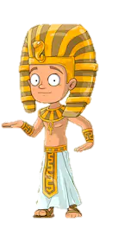
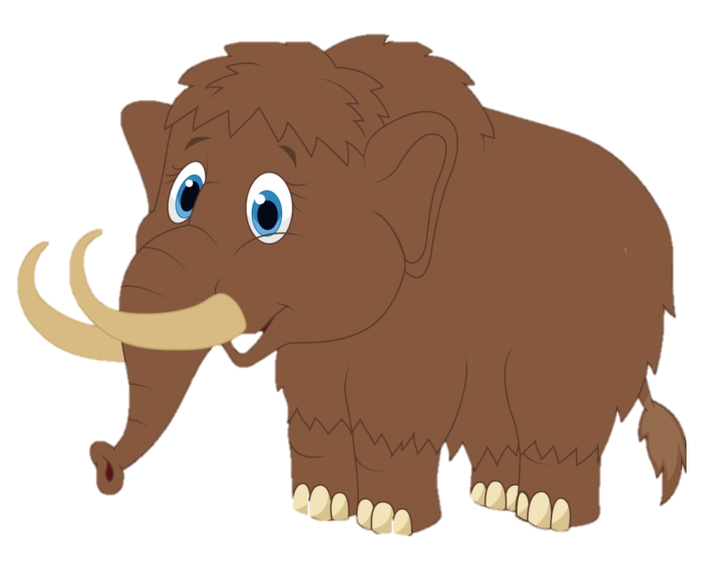
Chronology
Centuries vs Years?
We live in the year 2020 or 21st century.
There is a simple rule to work out the year or century of a time period.
2020, add 1 = 21st century
Chronology partly involves naming and putting historical events in time order.
For example:
Day (24 hours)
Week (7 days)
Month (4 weeks)
Year (12 months)
Century (100 years)
These are all examples of time periods - from the shortest to the longest.
When we look at chronology we put historical events and times into the correct time order.
Your turn - Can you work out the centuries for these years?
1066
1348
1485
1603
1798
1801
1945
Challenge yourself - can you do it with just 3 numbers?
762
543
928
No
cheating!
The problem with chronology is that sometimes two events happen at once.
Sometimes two events happen at the same time! For instance, woolly mammoths were still around at the same time the Egyptians were building their pyramids!
7
8

Slide 6
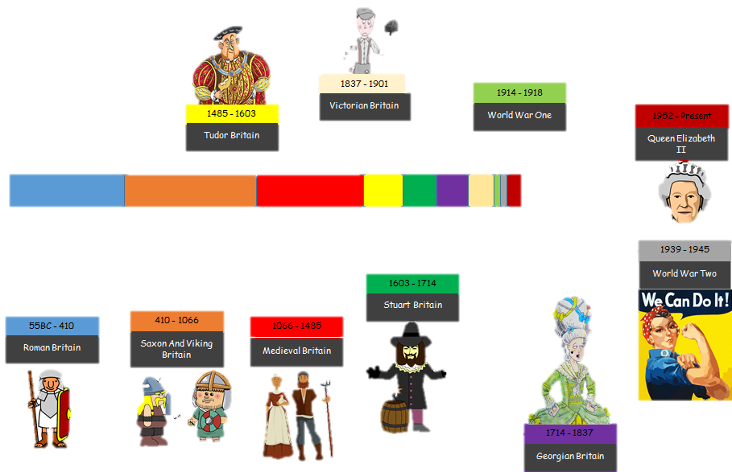

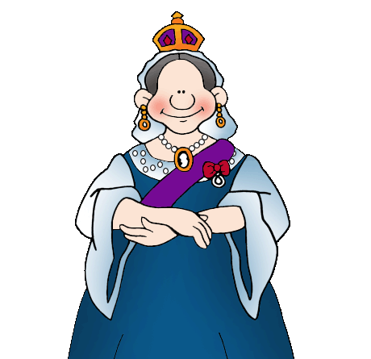
Can you find out something about any of these time periods? Write a short fact about each time period onto the timeline!
A quick tour of history time!
A lot has changed over time and there is still a lot we don’t know.
What we do know is that rulers have come and gone, some of them bringing about changes we can still see today.
The timeline on page 10 shows the history of England and then the UK, from the Romans to Queen Elizabeth II.
Did you know…
The Victorians invented Marmite. It was originally used as shoe polish!
9
10

Slide 7
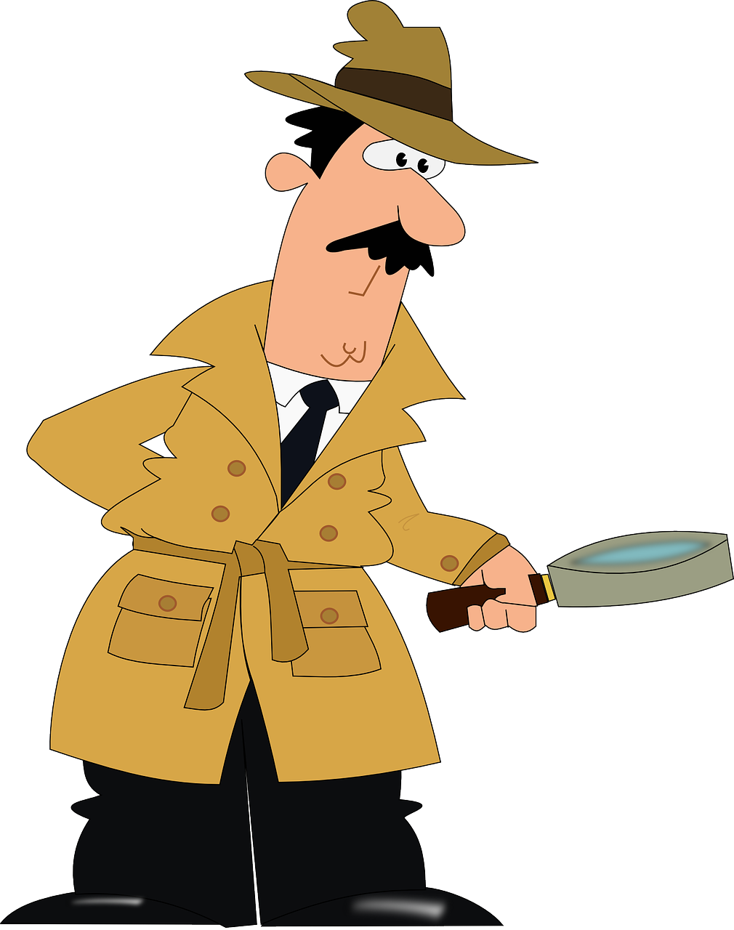
Historical concepts
Once upon a time there was a camel called Alphonse. Unfortunately, the camel had severe back problems. This was not the end of his misfortune, however, because he had an evil owner, called Frank (the camel killer).
Frank regularly overloaded his camels before taking them on gruelling and unnecessary trips up and down mountains on his way to deliver goods to his customers. These customers, shockingly, did not care what was happening to the camels.
Well, one Friday, Frank had just finished loading up Alphonse and the other camels for yet another pointless round trip up and down the mountains. He had piled and piled the goods onto Alphonse’s back and was taking a break, reflecting smugly on his handiwork, chewing a straw. On a whim he decided to add the bedraggled straw he had been chewing to Alphonse’s load. Alphonse groaned obligingly. He eyed his owner with disgust. Alphonse keeled over and died of radical and irreversible back collapse.
Read through the story. What caused poor Alphonse’s death? Highlight all the different reasons you can find.
Historians work with lots of different concepts to help them understand history.
One example is causation. This means looking at what causes a big event to happen. There usually isn’t just one reason, there can be lots and lots!
What do historians have in common with detectives?
We aim to find out the truth by examining the evidence!
11
12
Thanks to Arthur Chapman for creating Alphonse!

Slide 8
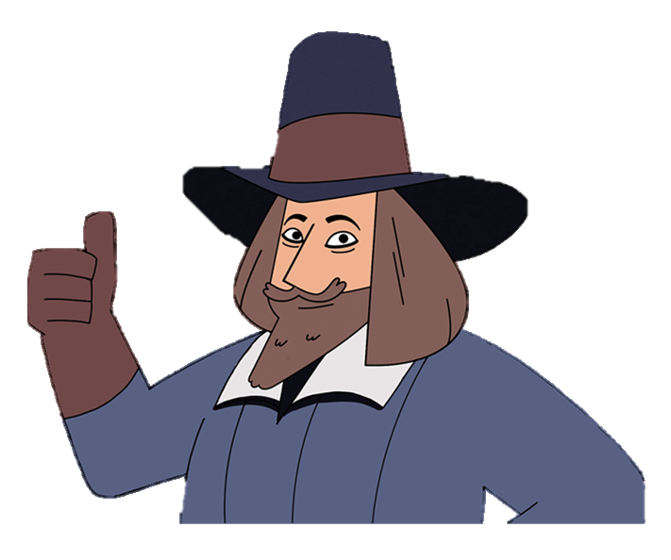
History is all around!
Can you complete your own blue plaque for your local area? It might be that someone of historical importance was born near you, or something happened that was important. It might help to ask someone or have a look online.
Some people think of history as being just about Kings and Queens but there is history everywhere, from the smallest village to the biggest city.
Local history is the study of history near where we are. It is important to remember our local history, and is sometimes remembered by blue plaques, like the one below:
Guy Fawkes
Gunpowder Plot Conspirator
Born Here at 32 Stonegate, York 1570
Hung, Drawn and Quartered, London 31st January 1606
This is where ……………………………………..
On this date ……………………………………….
This is what happened …………………………..
……………………………………………………………………..
………………………………………………………………………..
……………………………………………………
……………………………………………
Did you know…
Every 5th November we celebrate that Guy Fawkes didn’t manage to blow up Parliament! We call it Bonfire Night.
13
14

Slide 9
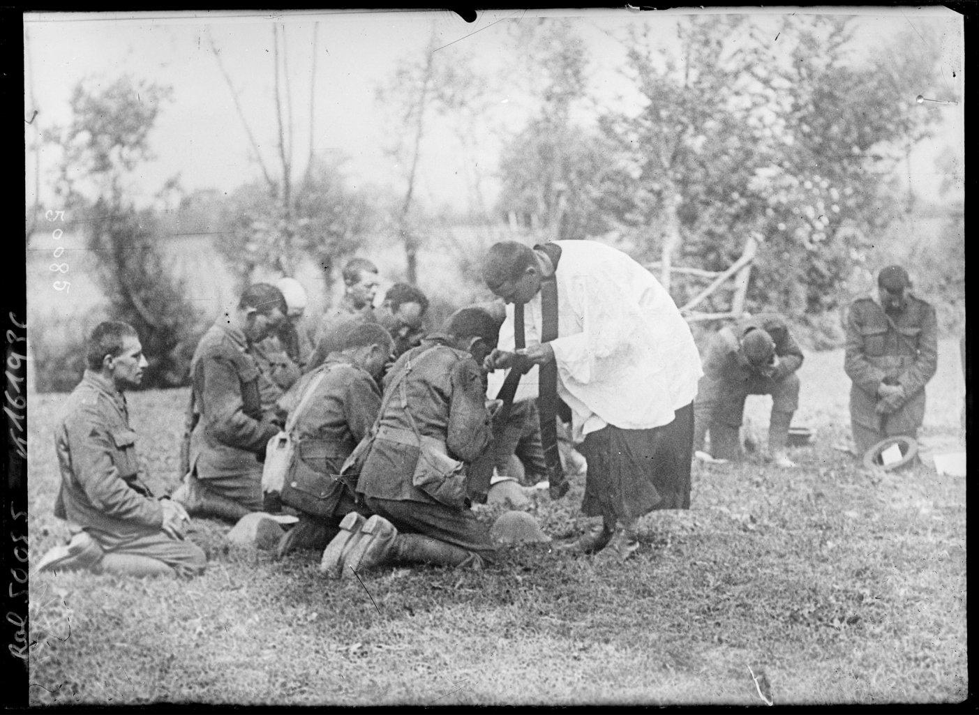
What's a primary source?
A primary source is written or otherwise produced at the time. It is a first-hand account, observation, viewpoint, or artefact.
Think: I was there.
No
cheating!
This image was published in August 1917 during World War One. This photograph is of an Italian priest blessing English soldiers in a field. It shows the personal devotion of many troops during WWI, and the role of religion in war.
THINK: Why do you think soldiers may have relied so heavily on religion in wartime?
TASK: now see if you can answer your 3 questions!
If your questions have not been answered, where could you find more information?
Look at the source.
What would you like to find out about this source? What important questions do you think need answering about this source? Try to think of three questions:
15
16
* Source from the British Library Online, Prêtre italien donnant la communion à des soldats anglais, August, 1917, https://www.bl.uk/collection-items/italian-priest-communion-english-soldiers.

Slide 10
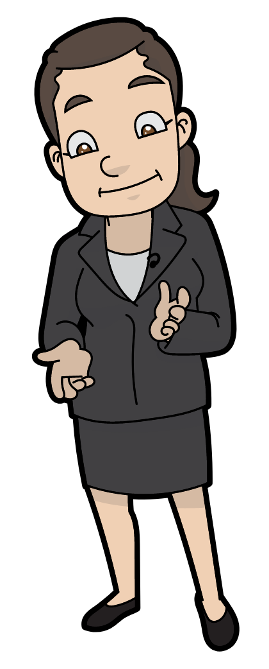
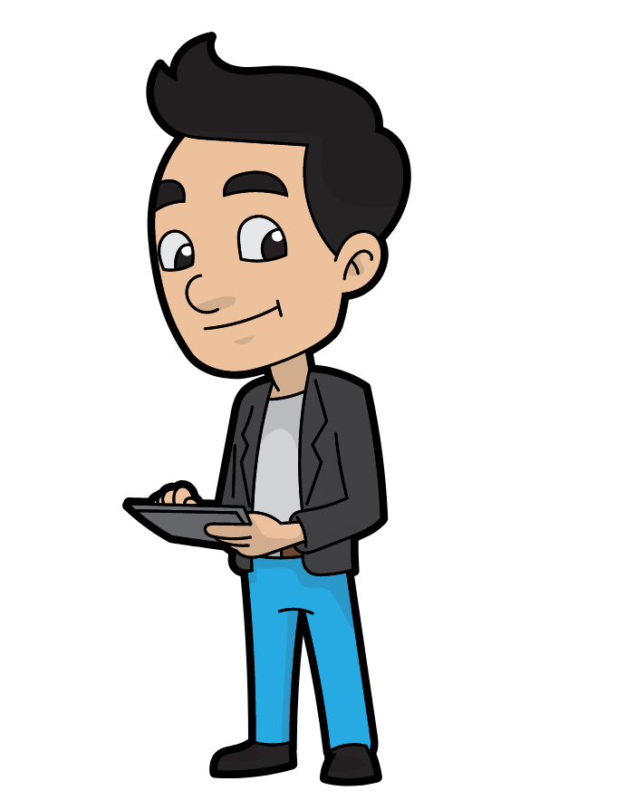
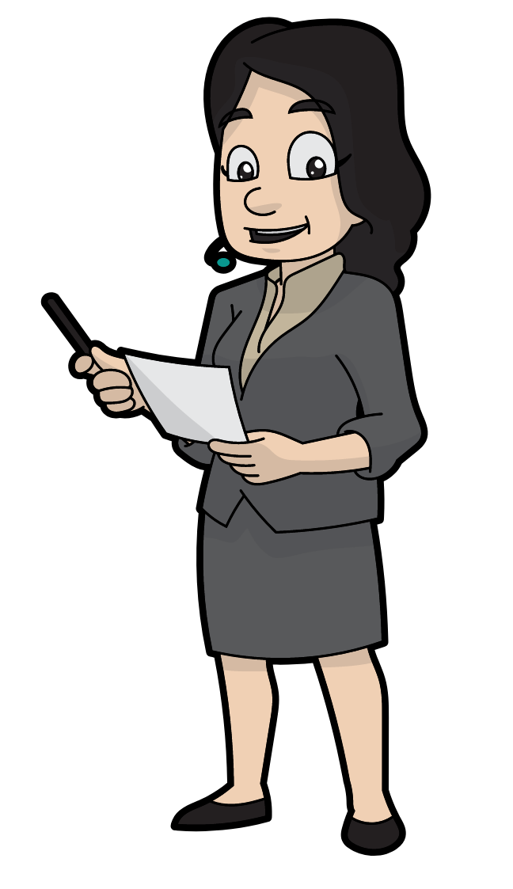
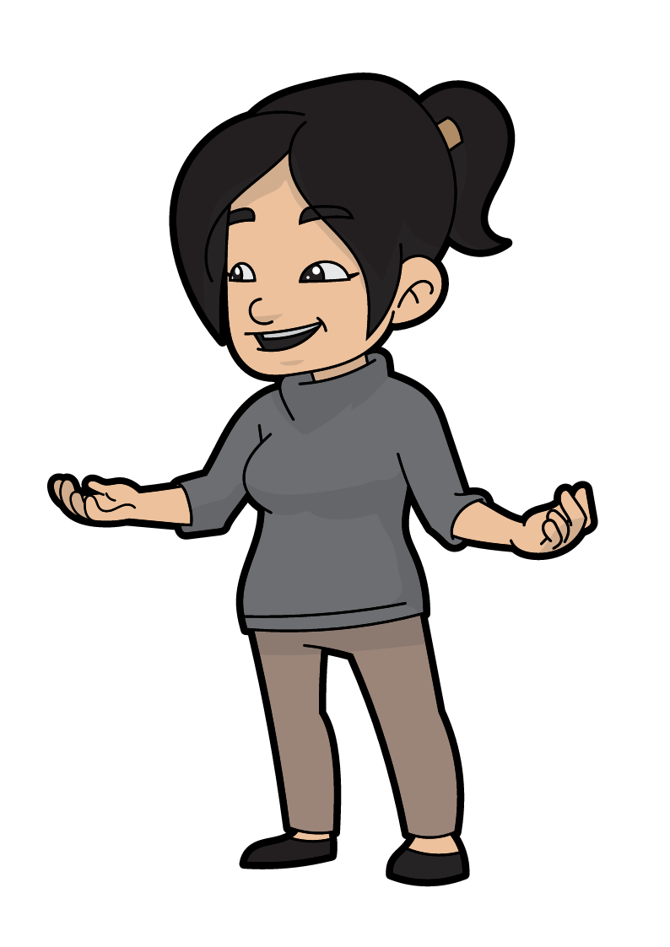
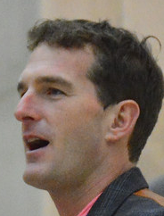
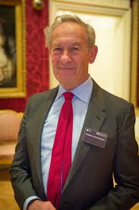
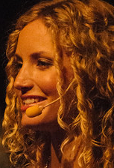
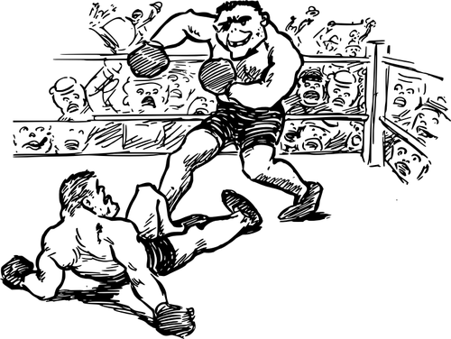
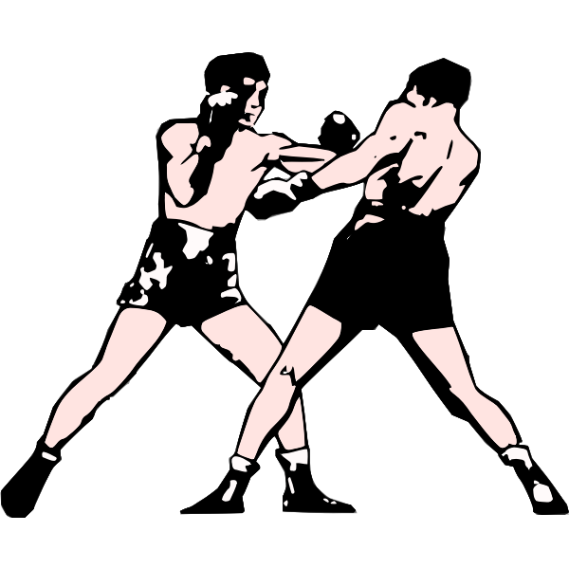
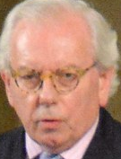
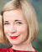
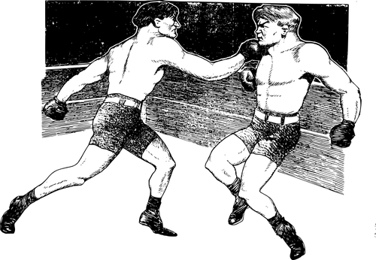
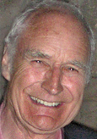
What's a secondary source?
Make a judgement!
A secondary source is an account, record, or evidence that comes from an original or primary source. The purpose of these sources is to analyse and assess a historical event.
Think: I heard or learned about it from somebody who was there.
Historians disagree about the importance of historical accuracy for public audiences. Some historians believe that when films are historically inaccurate this will confuse public understanding of history. However, other historians believe it’s all just a bit of fun! What do you think?
Our history belongs to all of us, and major events shouldn’t be the playthings of moviemakers to boost their box-office earnings.
The role of historians is to step in and say ‘I’m really glad you enjoyed that, but here’s a really interesting blog about how it’s not true, but this period of history is great so if you want to know more here’s a book’.
Greg Jenner
Battle of the historians
Historians study, evaluate and create interpretations of historical events based on primary and secondary sources. Historians often disagree with each other about interpretations of the past. One historian might look at the source on page 15 and draw entirely different conclusions from it. But that’s ok! This active dialogue is what makes history so great.
It is now your job as a newbie to examine what different historians say and whether this impacts your interpretation of the past!
Elizabeth Drew
How many people will have a wrong version of their own history and the history of Europe? I think that is problematic.
Estelle Paranque
For me, what’s important is, ‘is the narrative meaningful for the time in which it’s set’, not ‘have we sourced the right kind of wine glass?’.
Hannah
Greig
I think that historical accuracy in films ____________ ________________________________________________________________________________________________________________________________________________________________________________________________________________
Over
to you!
17
18

Slide 11
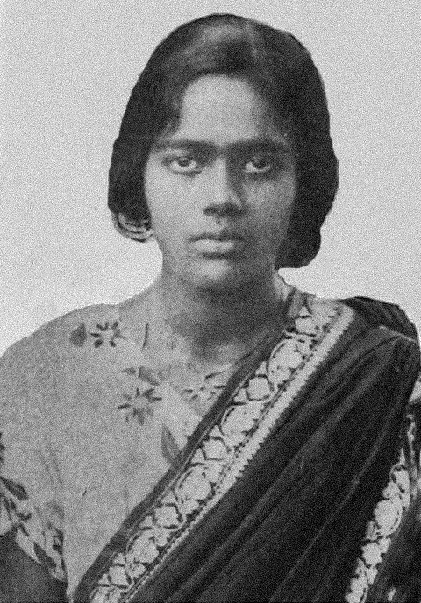
Between 1497 and 1763, English seamen travelled to (for them) new lands, set up colonies and traded all over the world. In the 18th century, Britain fought a number of wars against France and local people, resulting, for example, in British control of India. Indian people were treated cruelly and with violence. Parts of India began to rise up against British control.
The British say that one English life is worth more than one Indian life and that as a race, Indians are stupid, childish, simple, uncivilised savages, unable to govern themselves. After a while, the Indian man believes this. It is the same with Indian women. We now believe we are worth less than men.
I am doing this for you and all the women in my life.
Pritilata starts to tie her hair up and then wraps a turban around her head. Pritilata starts to change out of her sari [dress] and pulls on a pair of trousers (...) and the jacket of a soldier’s uniform over her sari blouse.
The Indian Republican Army have given me strict orders to lead a group of seven brothers.
Pritilata gets the gun out and places it carefully next to her.
The plan is to lead an assault on the European club, to shoot and kill the Europeans and then destroy the place, burn it to the ground and it has to be done as quickly as possible. After that, I will have to go into hiding, so I may not see you for a while… All British officers and their families are legitimate targets because all are here to forcibly take our country’s wealth and beat our people into submission. I feel fortunate for being a member of an organisation that is crowned with glory.
Pritilata died that night. She was 21 years old. She drank poison after being surrounded by the British to avoid arrest and execution.
History is not just the study of great white men!
THINK: why is it important to study a range of diverse histories?
PRITILATA - Bengal [India] 1932.
Ma. You warned me. I know you don’t want me hanging around here. But I can’t help it. ‘Troublemaker’! That’s what you call me but I want to cause trouble! Shake everyone and shout in their faces- ‘I can’t live like this any more! I have to breathe!’
‘Europeans only.
No dogs.
No Indians.’
Everywhere I look, I’m reminded of our enslaved condition in our own country. They [British] govern us with an iron hand, tell us it is their God-given right to take our land, force our labour, make us fight and die in their wars, starve us through famines. They say that the mere colour of their skin makes them superior [better] to us!
Ma, I know you wanted me to marry well and I am sorry that I chose not to follow that path. We walk through this world caring for the men, giving birth to them, waiting on them, and yet- we [women] are ghosts. I’ve heard you say ‘leave the fighting to the men. They are strong’. I am strong too Ma. I am no less than the boys. I am just as inspired to fight for freedom as any Indian man.
I hear that in England, women have the right to vote. Here, we don’t have any rights. Not the women, nor the men. We are all enslaved. So, we fight together. Ma, I’m going to do something tonight. I don’t know how it will end.
TASK: On a scrap of paper draw a mini mindmap and think about the following questions:
What does Pritilata’s story tell us about British rule in India? What does it tell us about treatment of Indian people?
What does Pritilata’s story tell us about views of women at the time?
How does the story make you feel? Is violence ever justified in your view?
19
20
* Tanika Gupta, ‘Pritilata’, Snatches, Moments from 100 years of women’s lives: eight monologues.

Slide 12
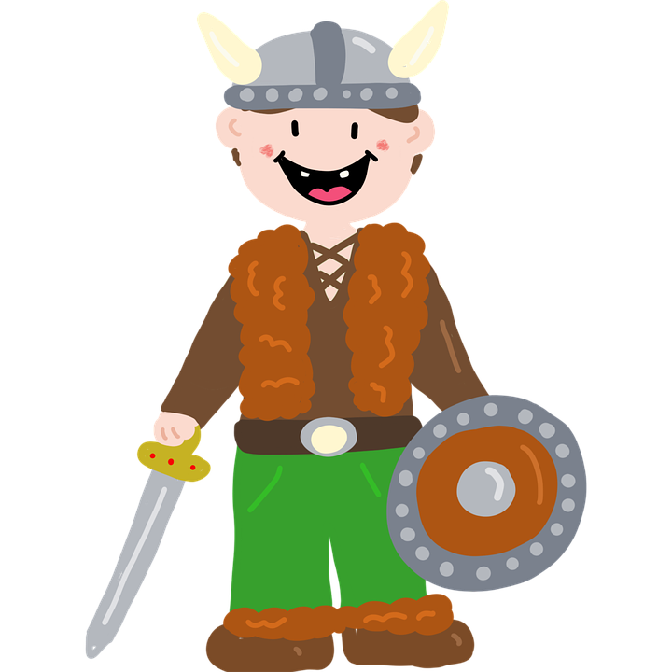
Trying putting these events in
chronological order
Try creating
images for
your timeline!
World War One
The Vikings
The Romans
Queen Elizabeth II
9/11
The Black Death
The Normans
Henry VIII
Queen Victoria
Dunkirk
Create your own timeline
Find your own history fact!
Did you know… Vikings skied for fun!
Did you know…
________________________
________________________
________________________
See the example
timeline on page 10
for help!
21
22

