Slide 1
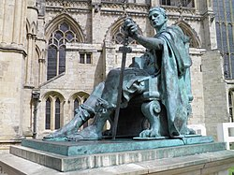
Welcome to YorkClio
The network for York History teachers

Slide 2
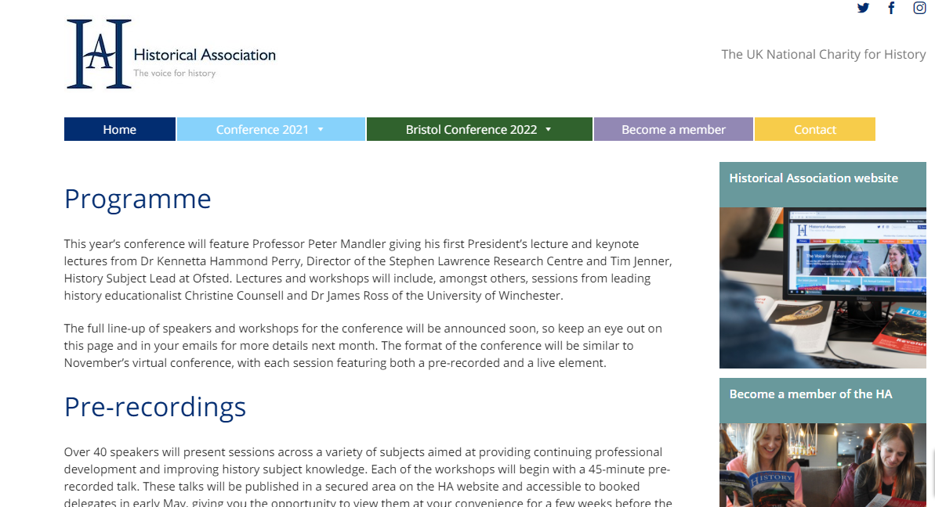
The HA Conference will take place from 24th to 29th May 2021. https://www.haconference.com/

Slide 3
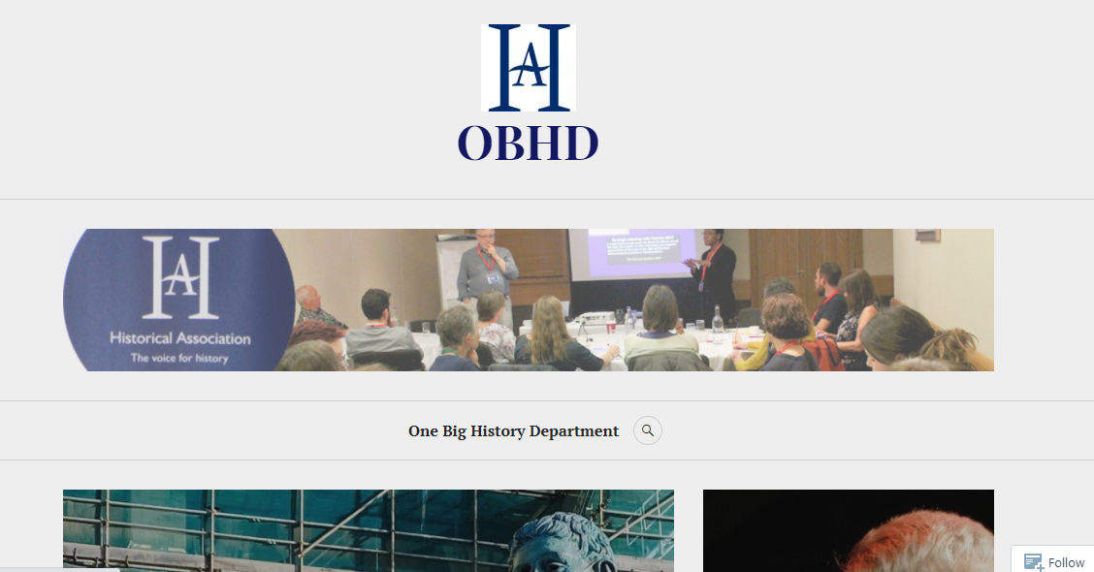
https://onebighistorydepartment.com/

Slide 4

https://bep.education/events/secondary-history-subject-development-day/

Slide 5
Lock down leearning
What have ben the biggest issues faced by your lower-attainers during lock down?
What advantages have there been for lower-attainers during lockdown learning?

